Slide 1
DNA Research

Slide 2
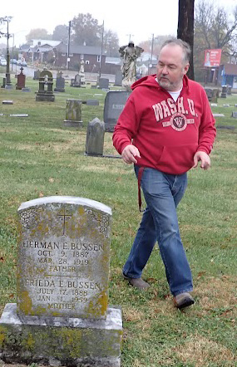
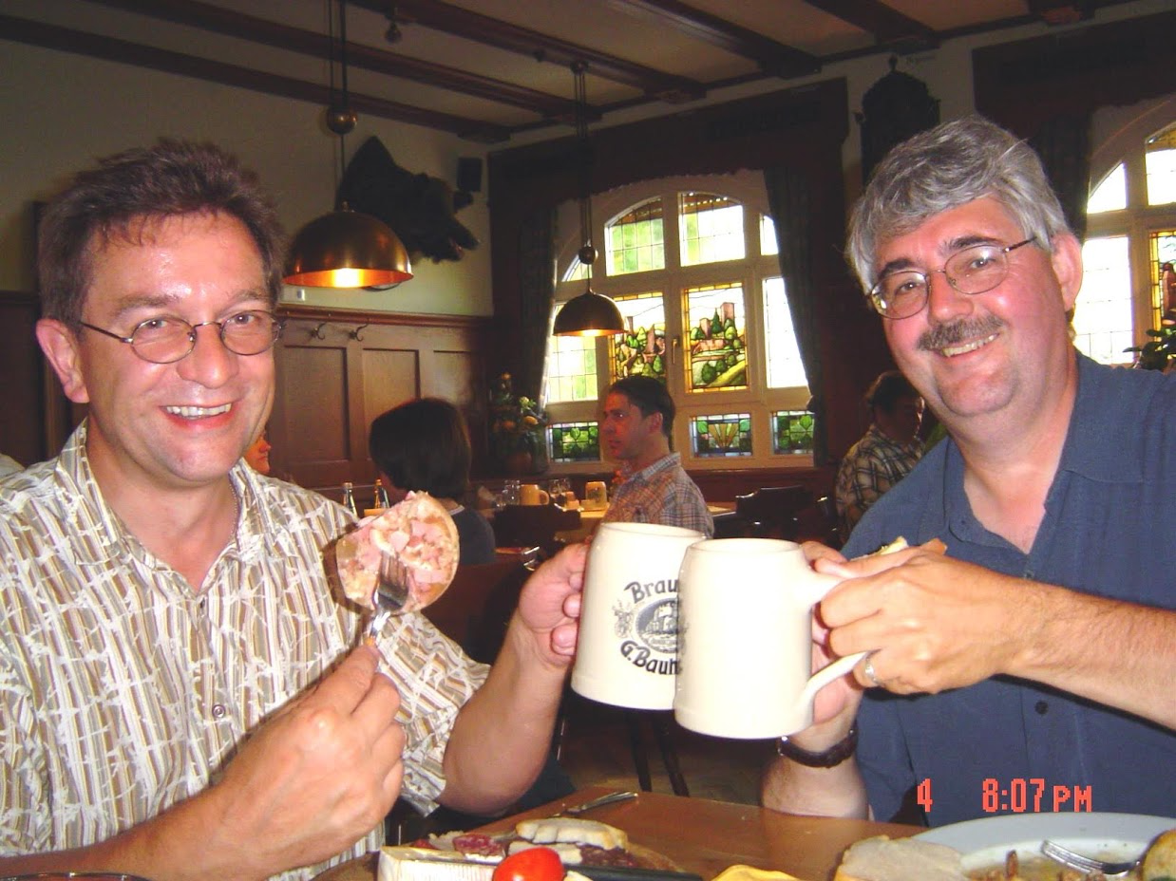

Blood Lines

Slide 3
DNA Research
I received my DNA Results, now what?
What’s New?
Technology and Science-Dr. Andor Kiss
Tracing Family Genealogy
Matching-Dr. Tom Montgomery

Slide 4
DNA Technology
Technology Improvements
Database Improvements
Bioethics-Catching Criminals example
Who owns your DNA
Markers and centimogans

Slide 5
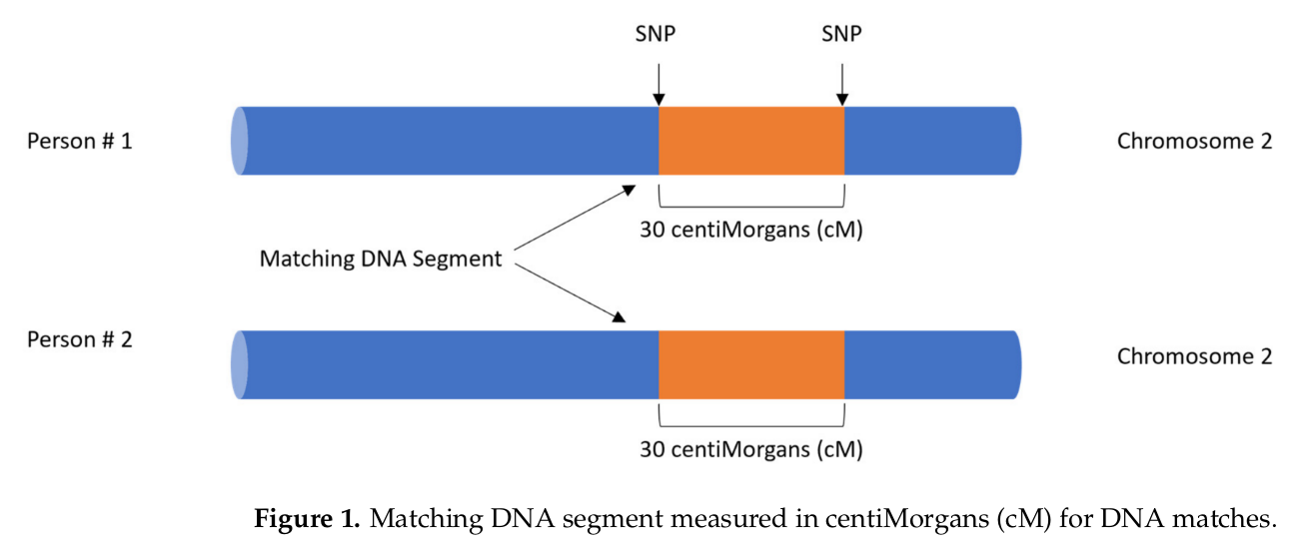
centiMorgans | Proxy for distance within a chromosome
From: Glynn, C. L. (2022). Bridging Disciplines to Form a New One: The Emergence of Forensic Genetic Genealogy. Genes 13, 1381. https://www.mdpi.com/2073-4425/13/8/1381

Slide 6
centiMorgans | Proxy for distance within a chromosome
A centimorgan (abbreviated cM) is a unit of measure for the frequency of genetic recombination. One centimorgan is equal to a 1% chance that two markers on a chromosome will become separated from one another due to a recombination event during meiosis (which occurs during the formation of egg and sperm cells). On average, one centimorgan corresponds to roughly 1 million base pairs in the human genome.
However, because recombination is different between females and males, cM distance of the male vs. female genome is different.
Reference: Kong, A., Gudbjartsson, D. F., Sainz, J., Jonsdottir, G. M., Gudjonsson, S. A., Richardsson, B., Sigurdardottir, S., Barnard, J., Hallbeck, B., Masson, G., et al. (2002). A high-resolution recombination map of the human genome. Nat Genet 31, 241–247. https://www.nature.com/articles/ng917z

Slide 7
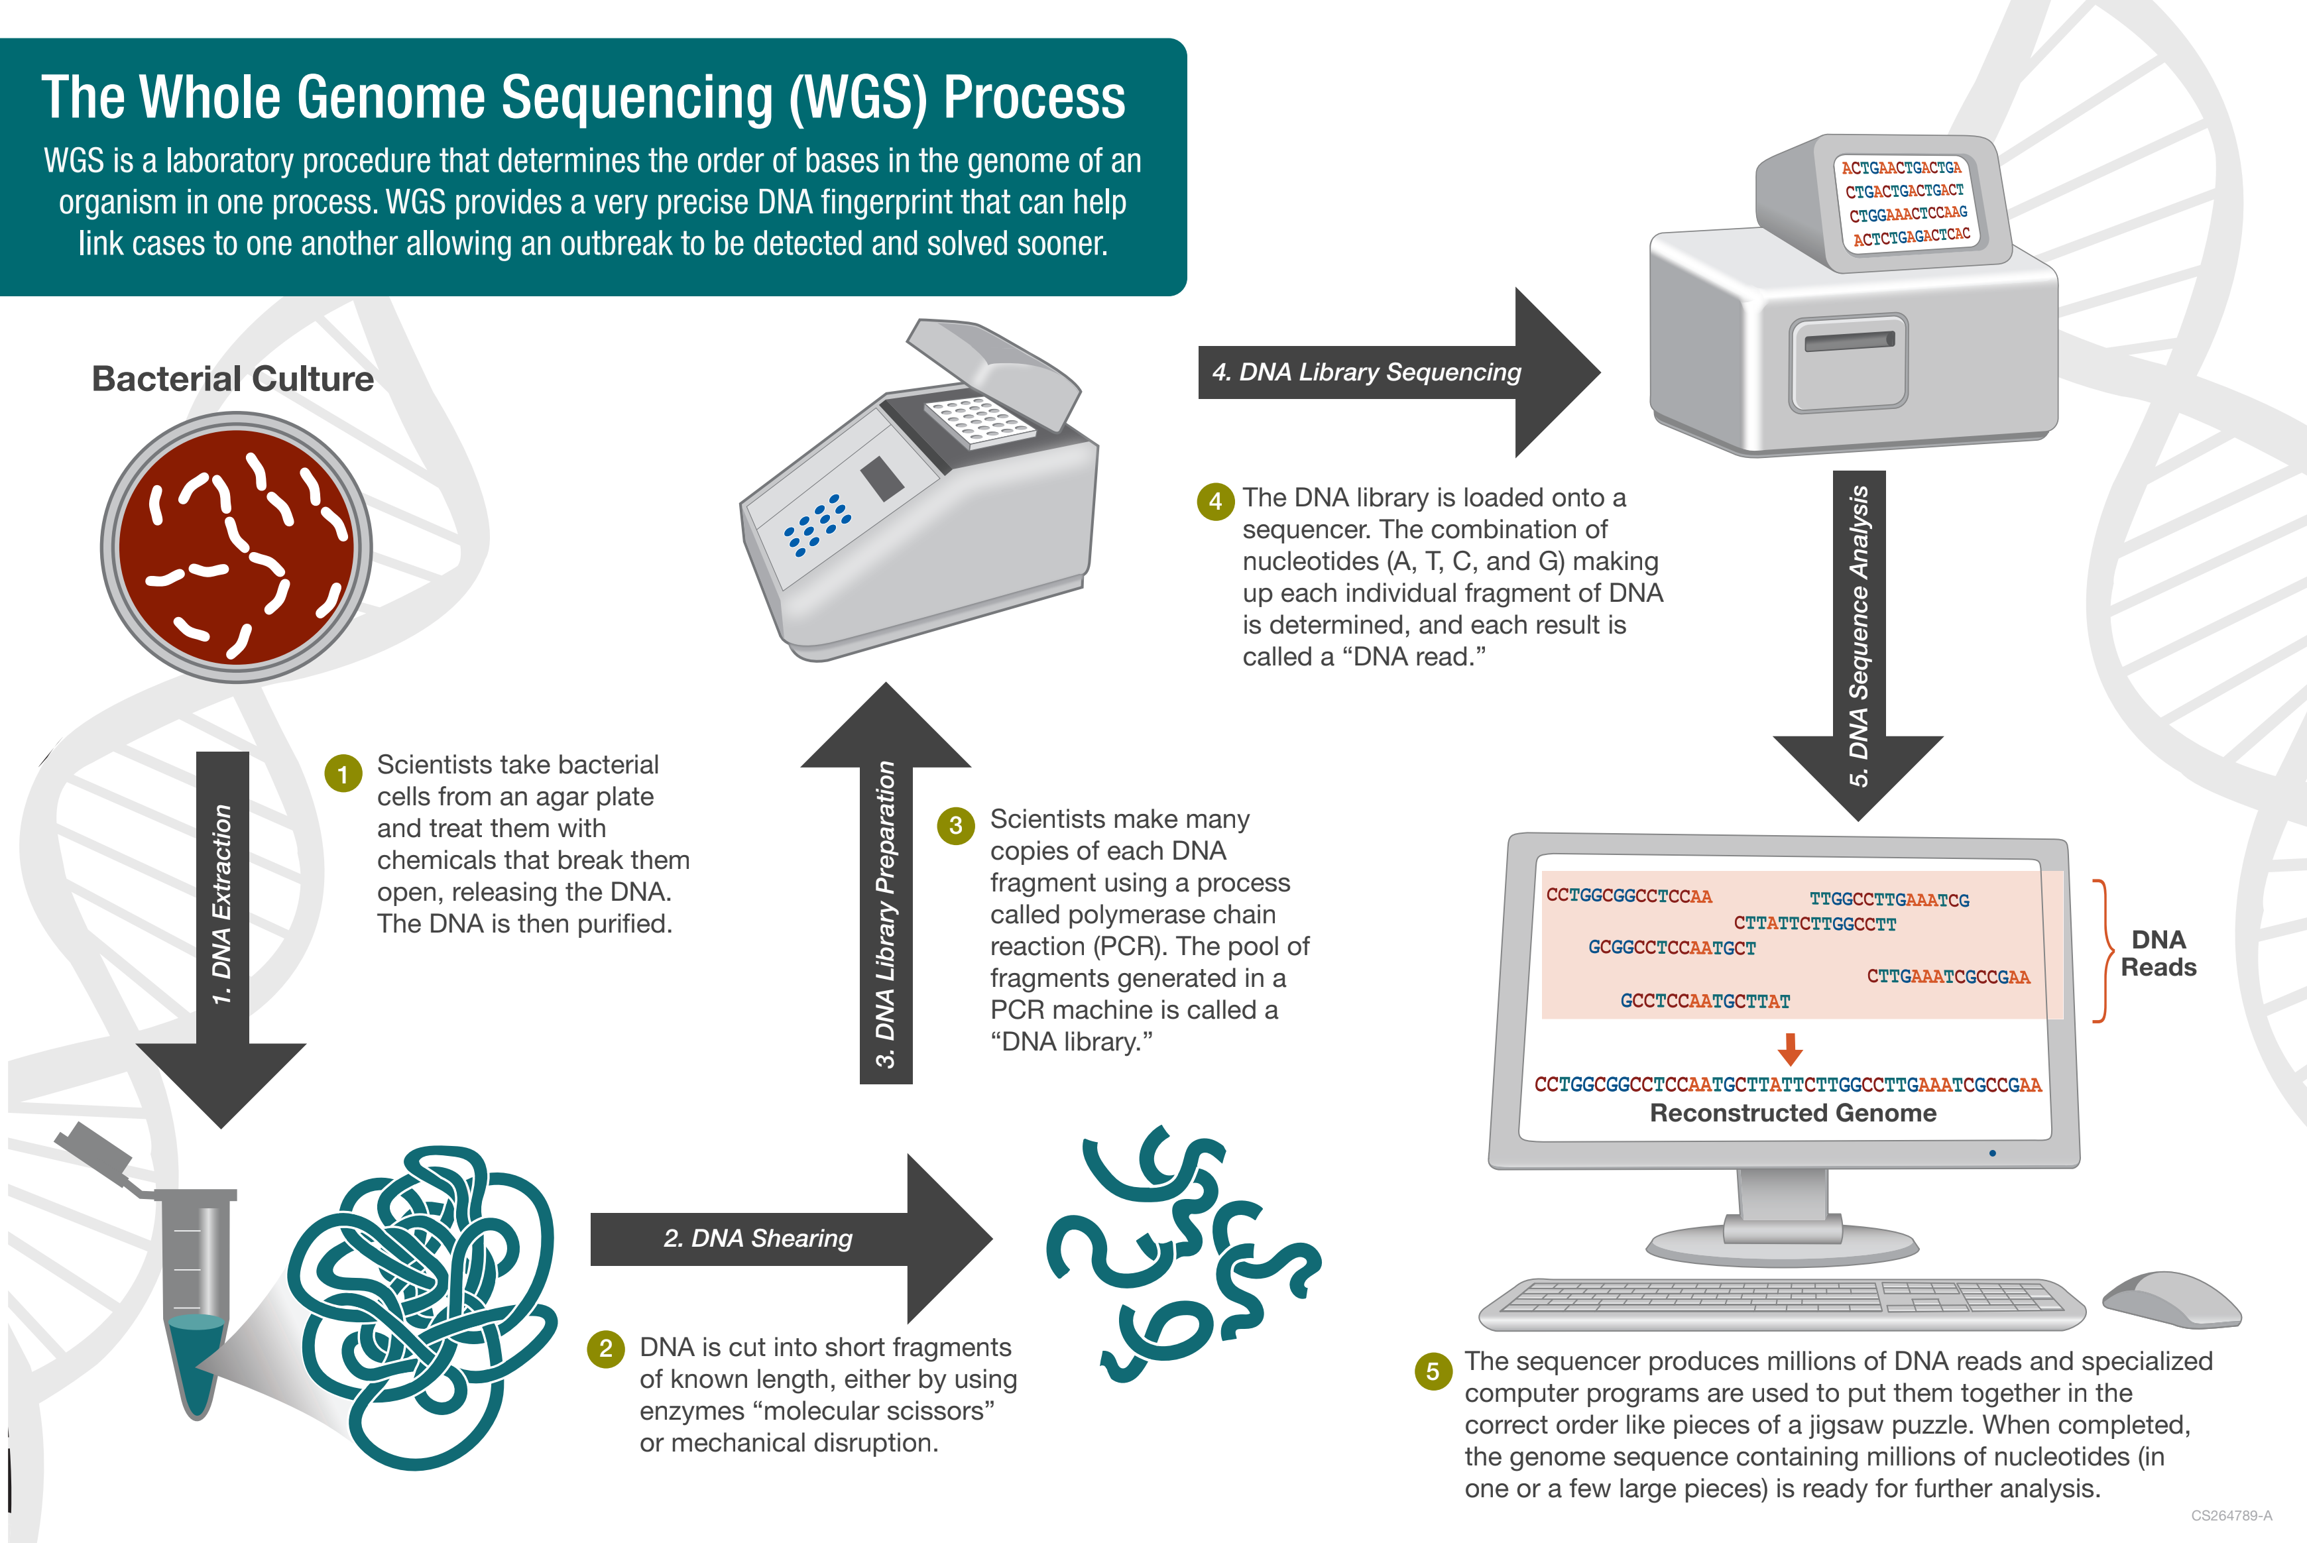
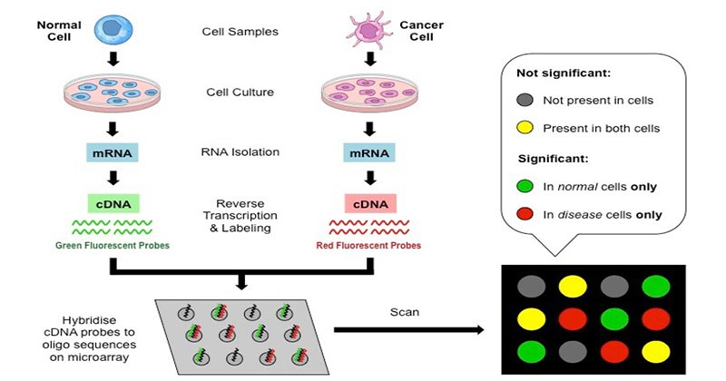
Technology & Science behind Genealogy Testing

Slide 8
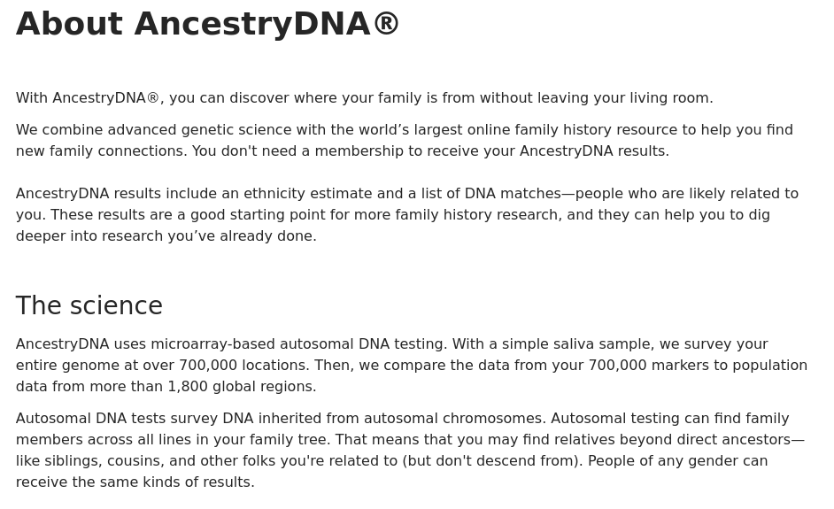
AncestryDNA & 23&Me | Microarray

Slide 9
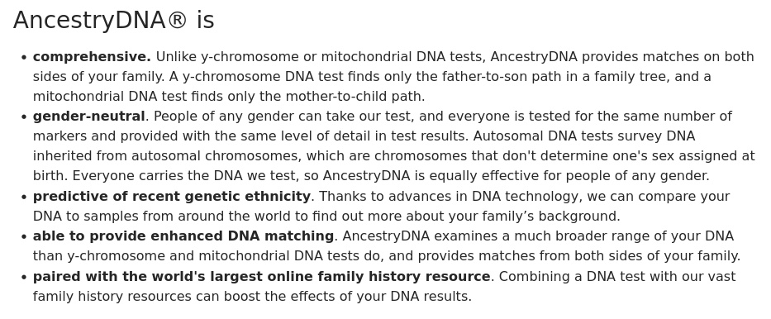
AncestryDNA & 23&Me | Microarray

Slide 10
AncestryDNA & 23&Me | Microarray

Slide 11
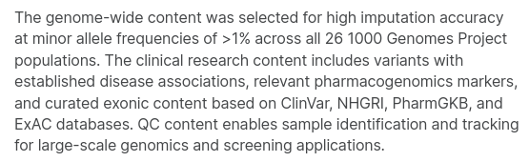
AncestryDNA & 23&Me | Microarray
23&Me : Illumina Infinium Global Screening Array (Custom)
Primary focus : Personalised Genomics
Treatment of an individual based on their specific genotype
Ethnicity (Race) plays into this, as certain ethnic groups carry specific markers
Illumina Infinium Global Screening Array

Slide 12
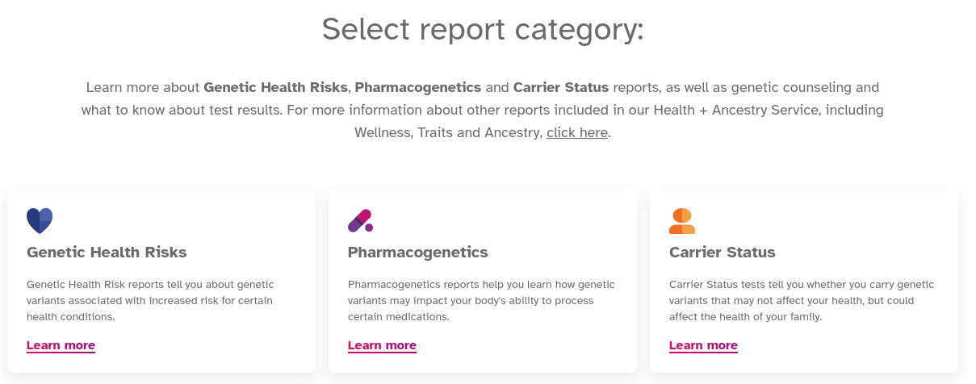
AncestryDNA & 23&Me | Microarray

Slide 13
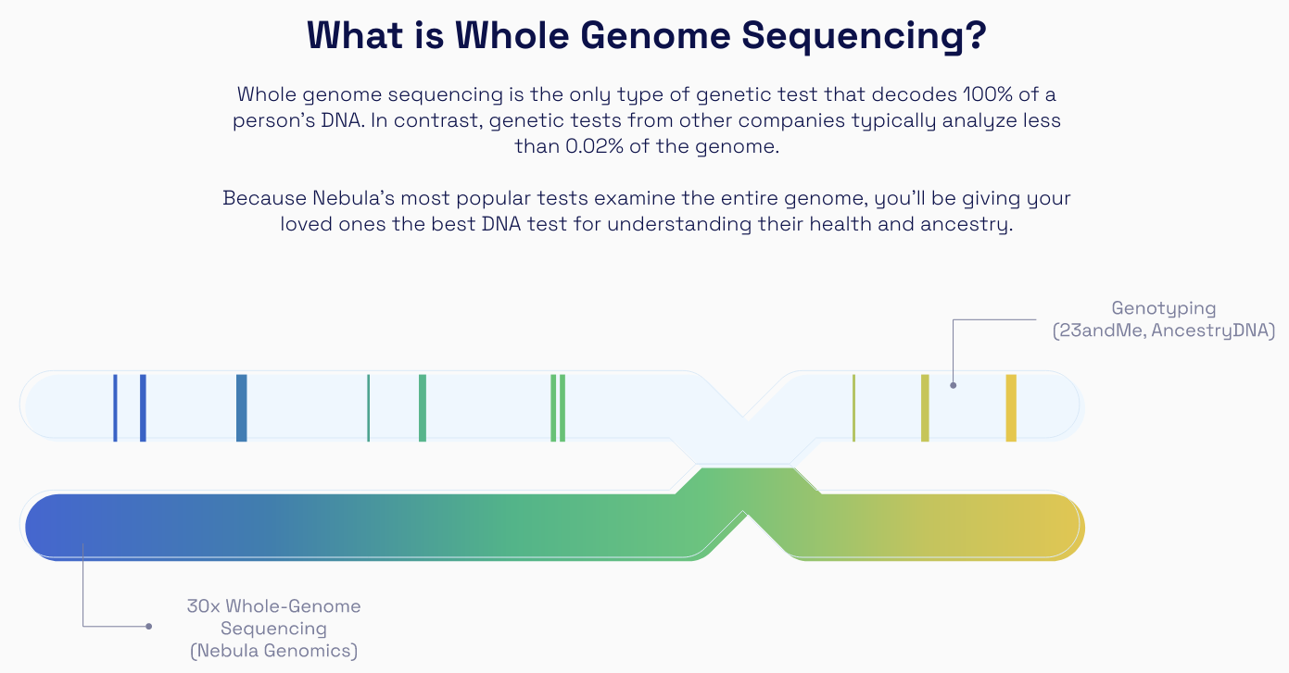
Nebula Genomics

Slide 14
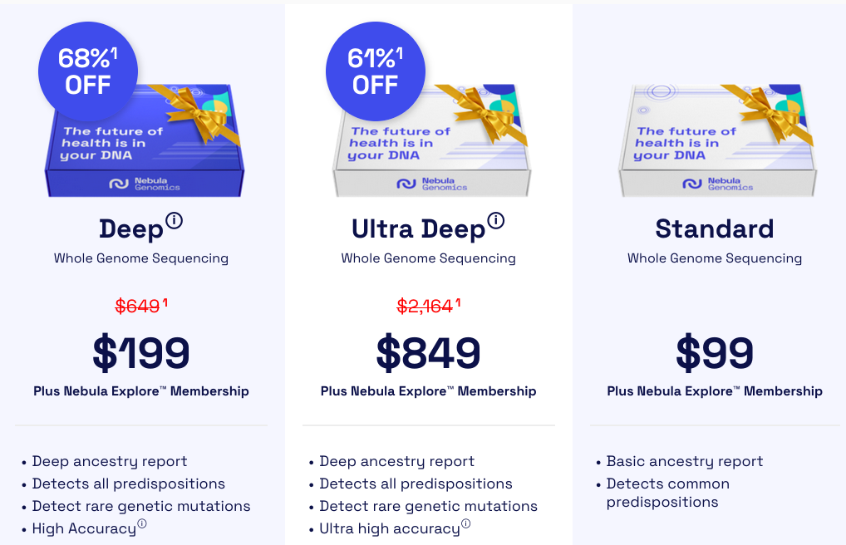
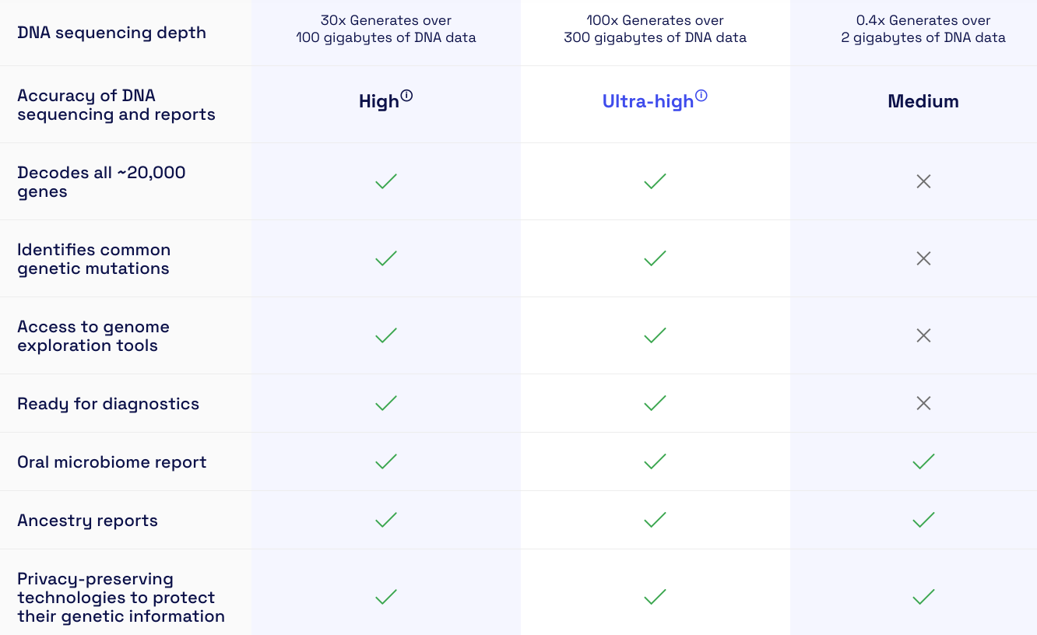
Nebula Genomics

Slide 15
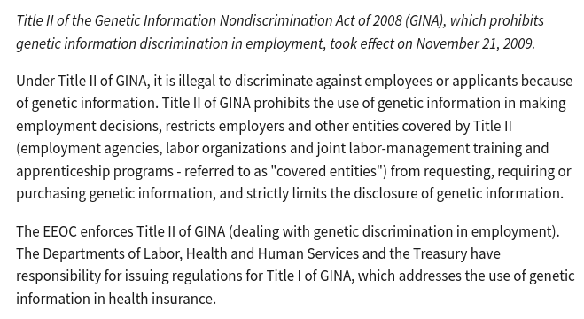
Genetic Information Nondiscrimination Act (GINA) 2008
URL: https://www.eeoc.gov/genetic-information-discrimination

Slide 16
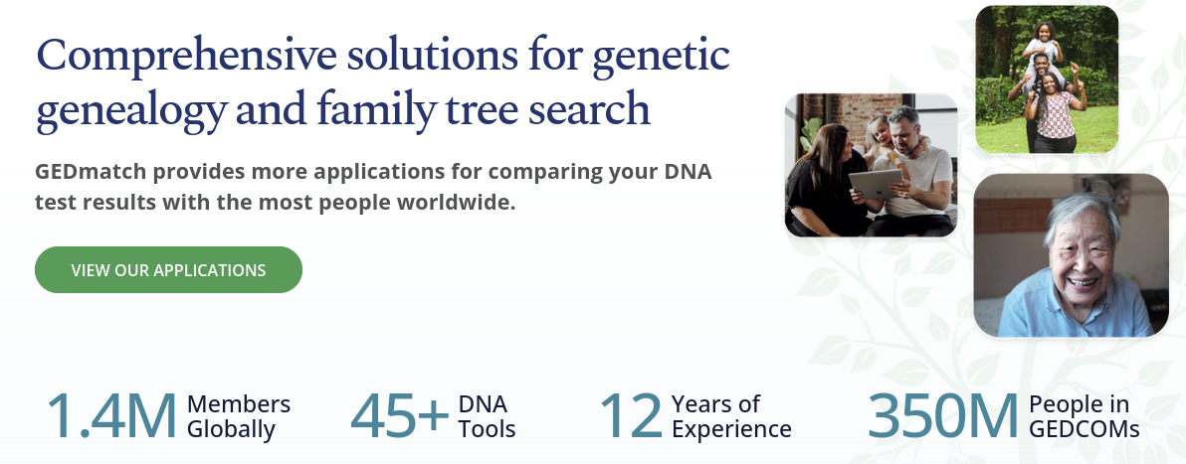
Forensic Genetic Genealogy | GEDmatch
Usage by law enforcement
In December 2018, police forces in the United States said that, with the help of GEDmatch and genetic genealogy, they had been able to find suspects in a total of 28 cold cases of murder and rape that year. Also in December 2018, Family Tree DNA allowed law enforcement agencies, including the FBI, to upload DNA profiles from crime scenes to help solve cold crimes. As of that time, GEDmatch was not the only site that could be used by law enforcement officials to solve crimes using genetic genealogy.
White people are overrepresented on GEDmatch and are believed to be underrepresented in CODIS, the FBI's collection of DNA samples pulled from crime scenes, arrestees, and criminal suspects. Thus, GEDmatch may be especially effective in facilitating the arrests of white suspects who might otherwise have eluded law enforcement. On May 18, 2019, GEDmatch revised its privacy statement to users regarding the collection and use of genetic information, including the circumstances in which it may cooperate with law-enforcement use of its database. As of September 2020, GEDmatch has been credited for helping facilitate nearly 120 cold-case arrests and for helping in 11 "Jane and John Doe" identifications across the United States.

Slide 17
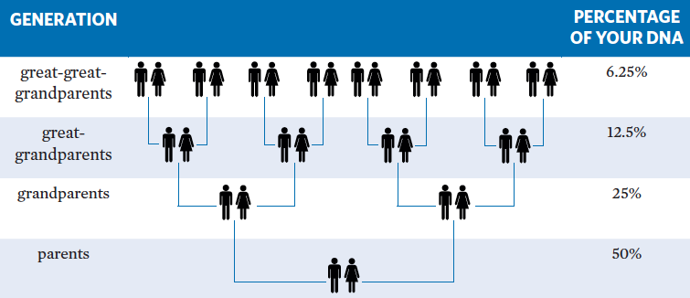
Percentage of DNA

Slide 18
DNA Testing Companies
Family Tree DNA (November, 2005)-added Big-Y, 2022
Ancestry (December, 2014)
Helix-National Geographic Society (February, 2017)
My Heritage (January, 2018)
23 and Me (December 2018-added Health later)

Slide 19
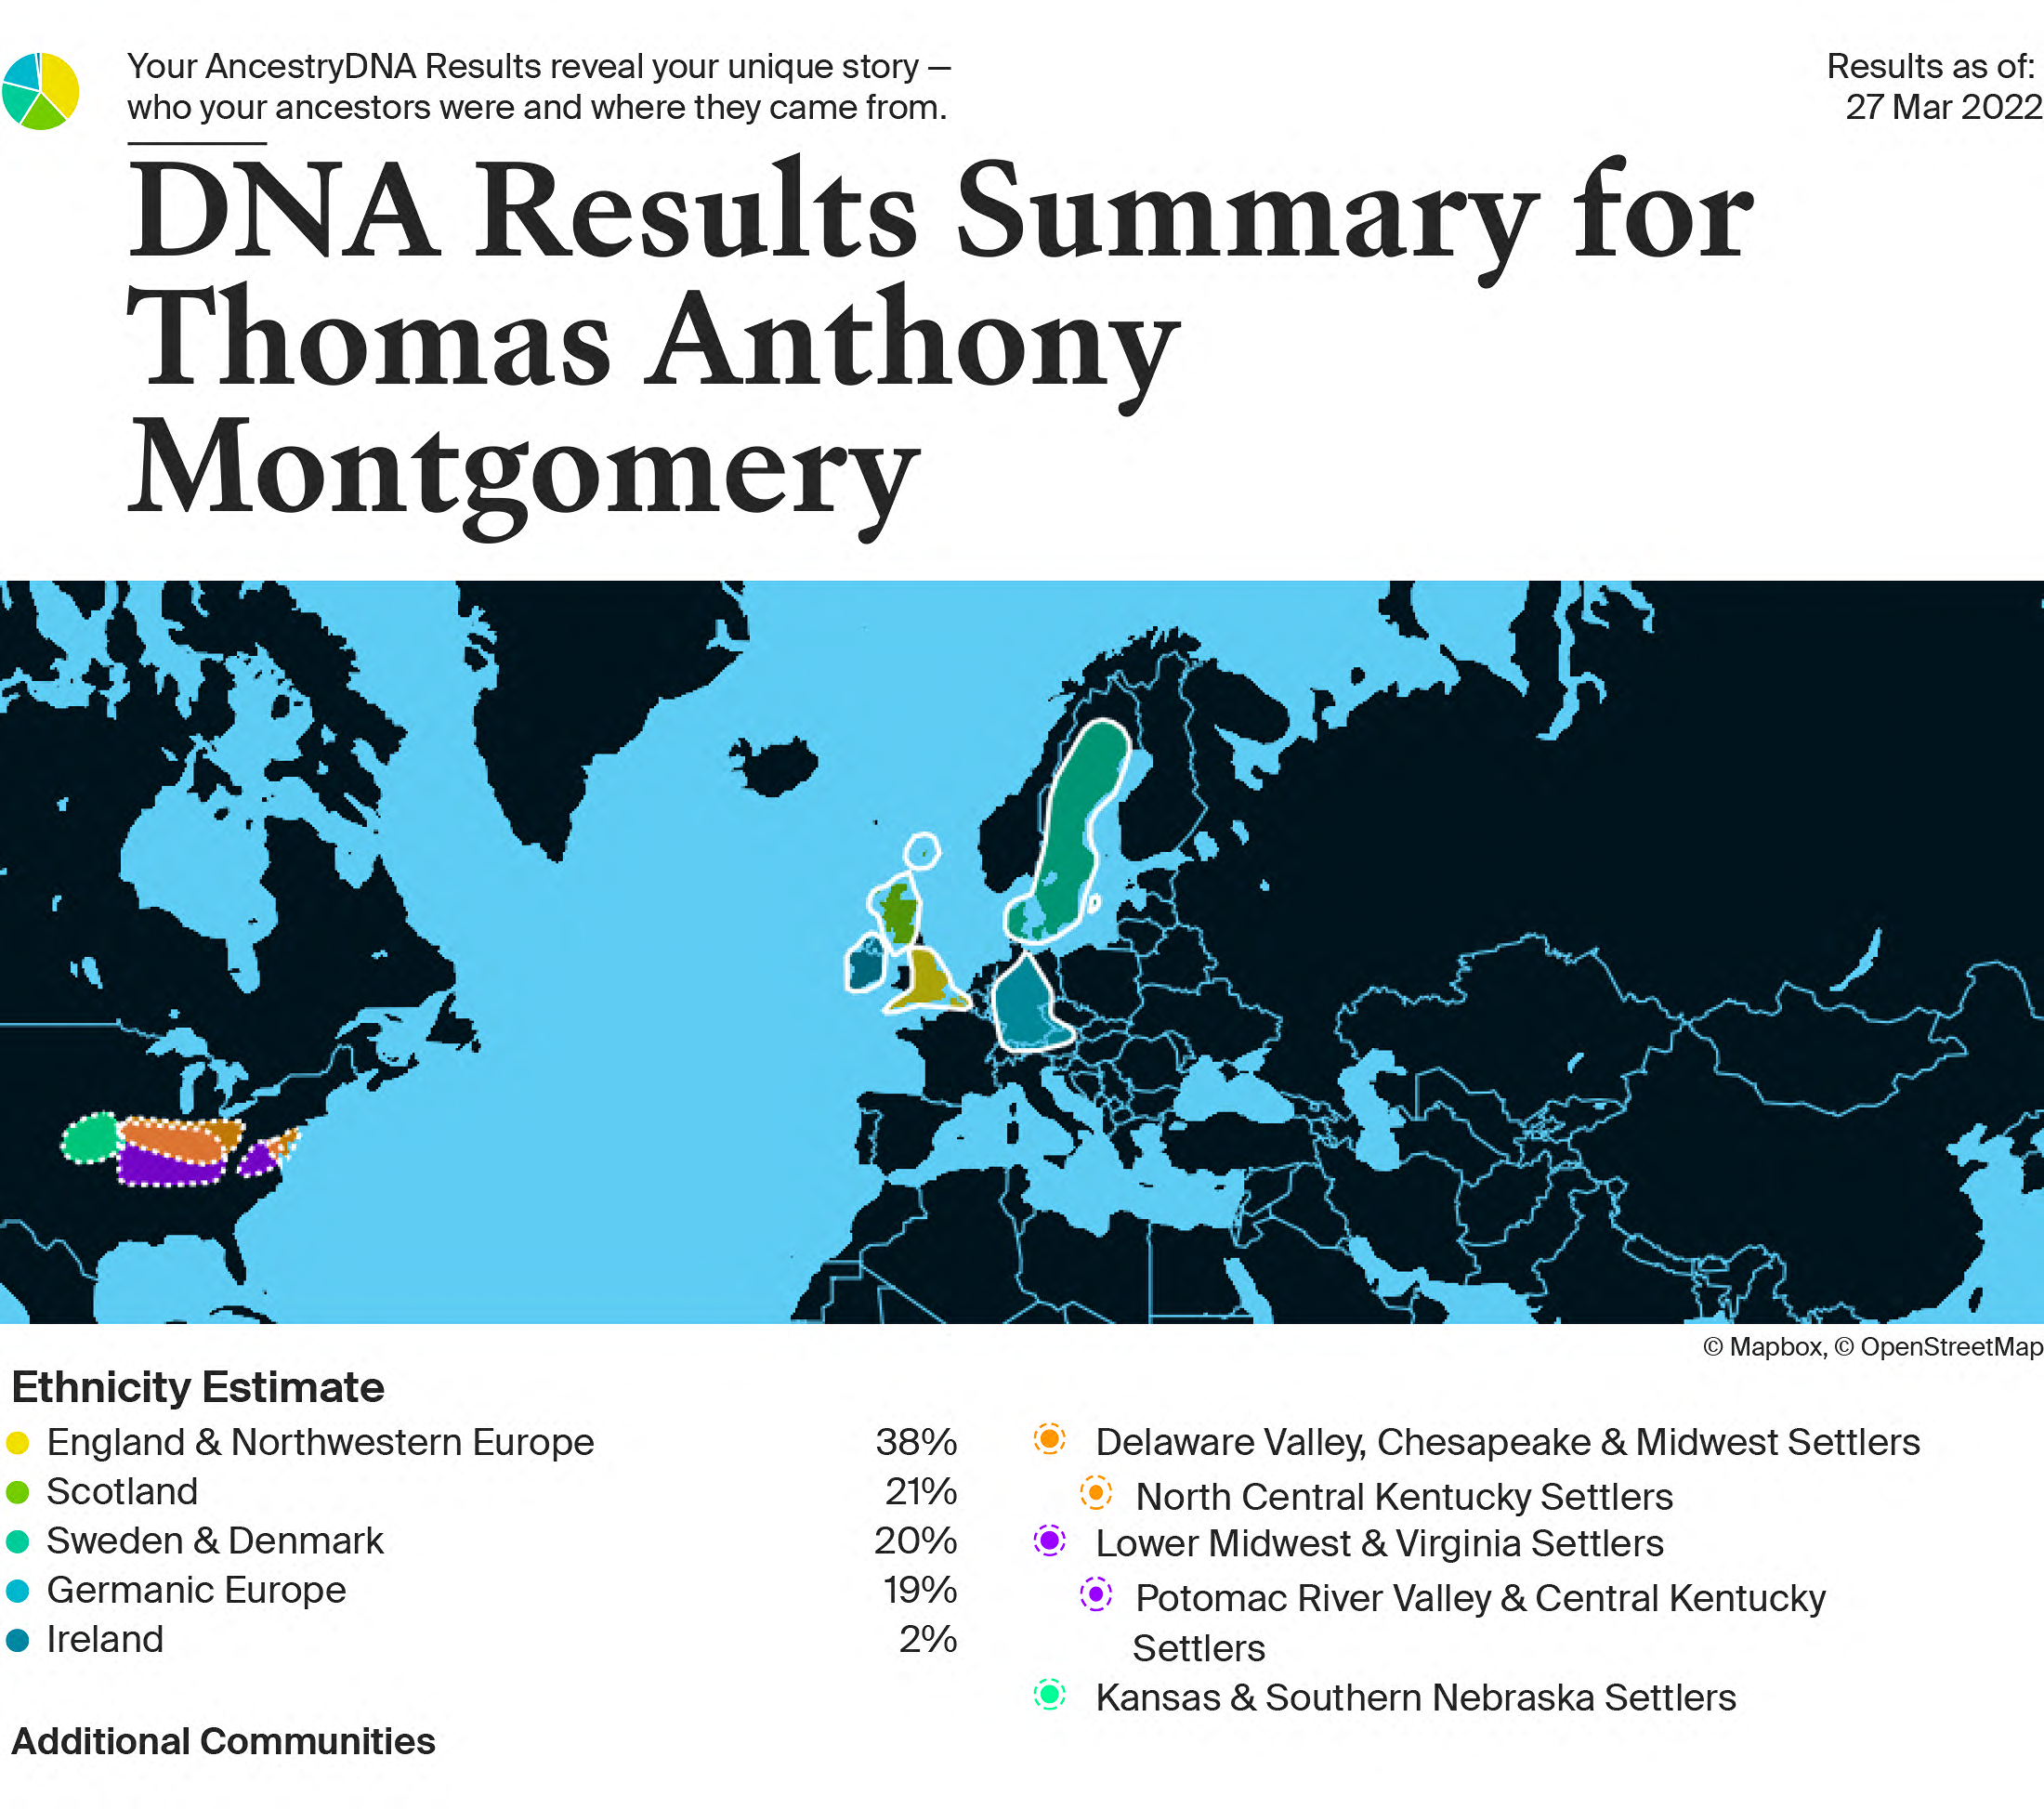
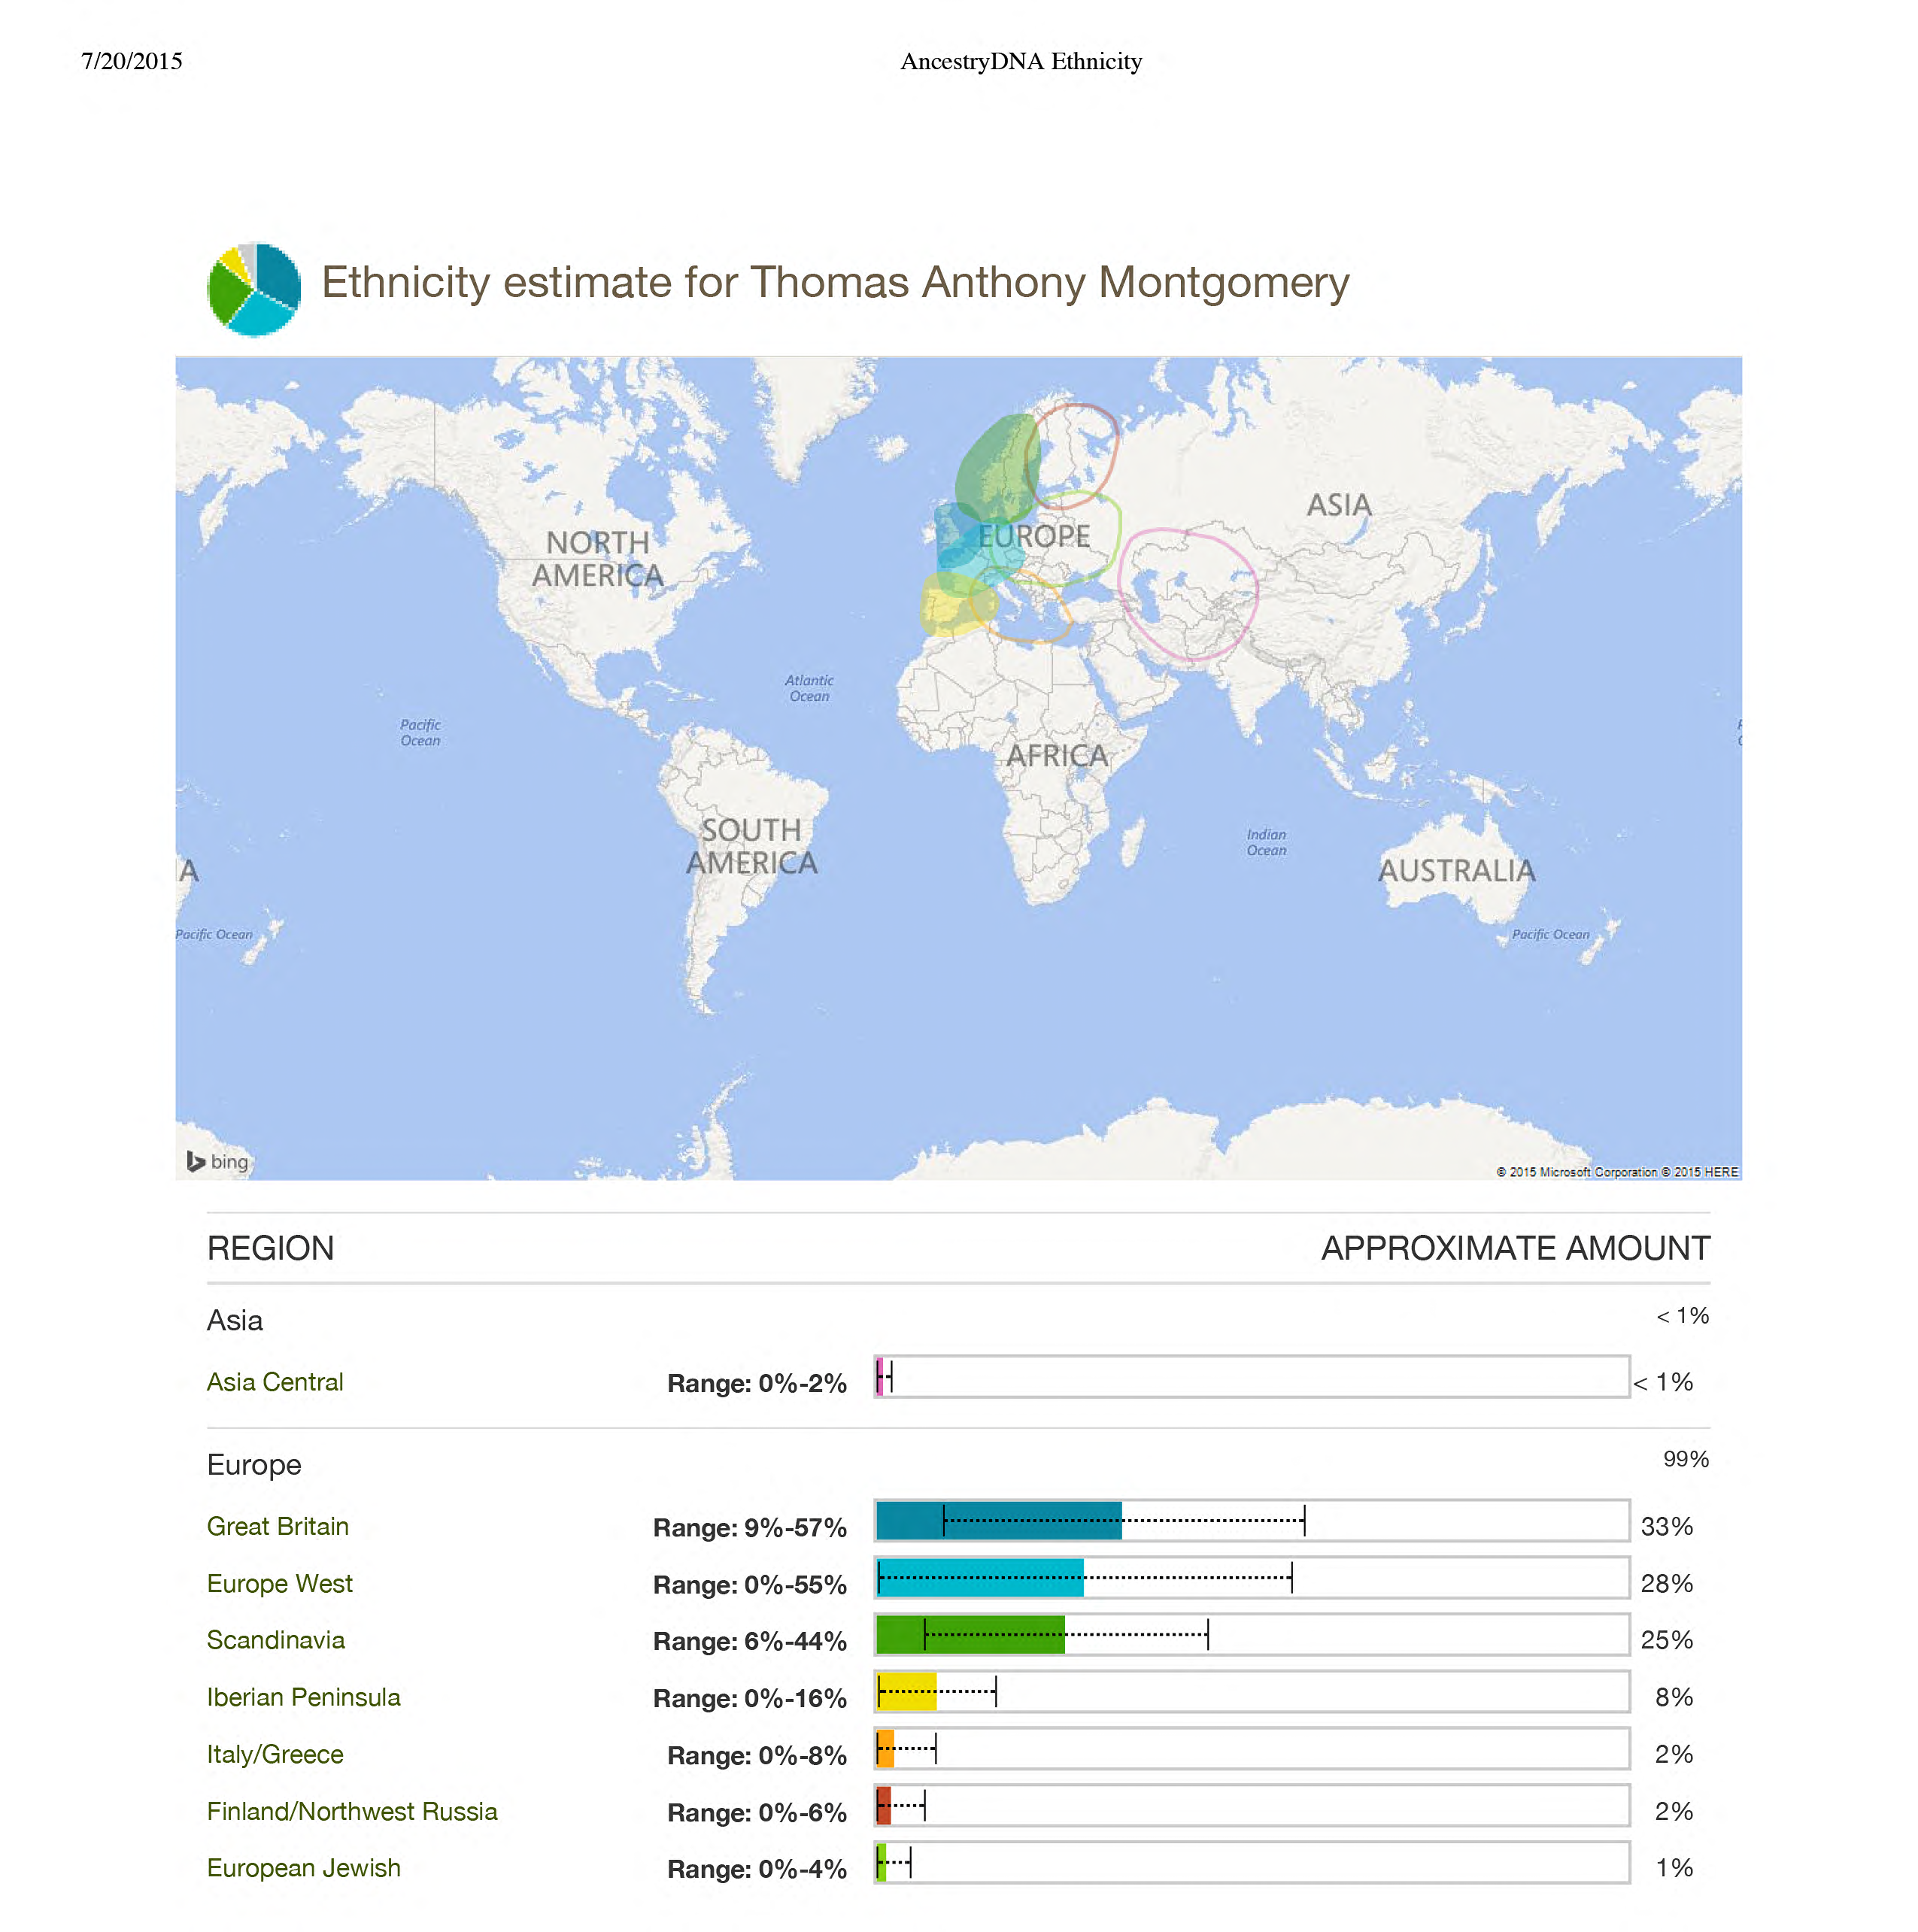
Ethnicity Results
Login to see current Ethnicity estimate.
Notes:
Discuss Old and New results.
Login to see the latest.
Touch on Ethnicity inheritance and Chromosome Painter.
NEW Sideview announced: https://www.youtube.com/watch?v=frxz76gn5tY
https://www.yourdnaguide.com/ydgblog/ancestrydna-sideview
https://www.yourdnaguide.com/ydgblog/ancestrydna-genetic-communities
https://www.ancestry.com/cs/ethnicity-guide
Label parents based on update.

Slide 20
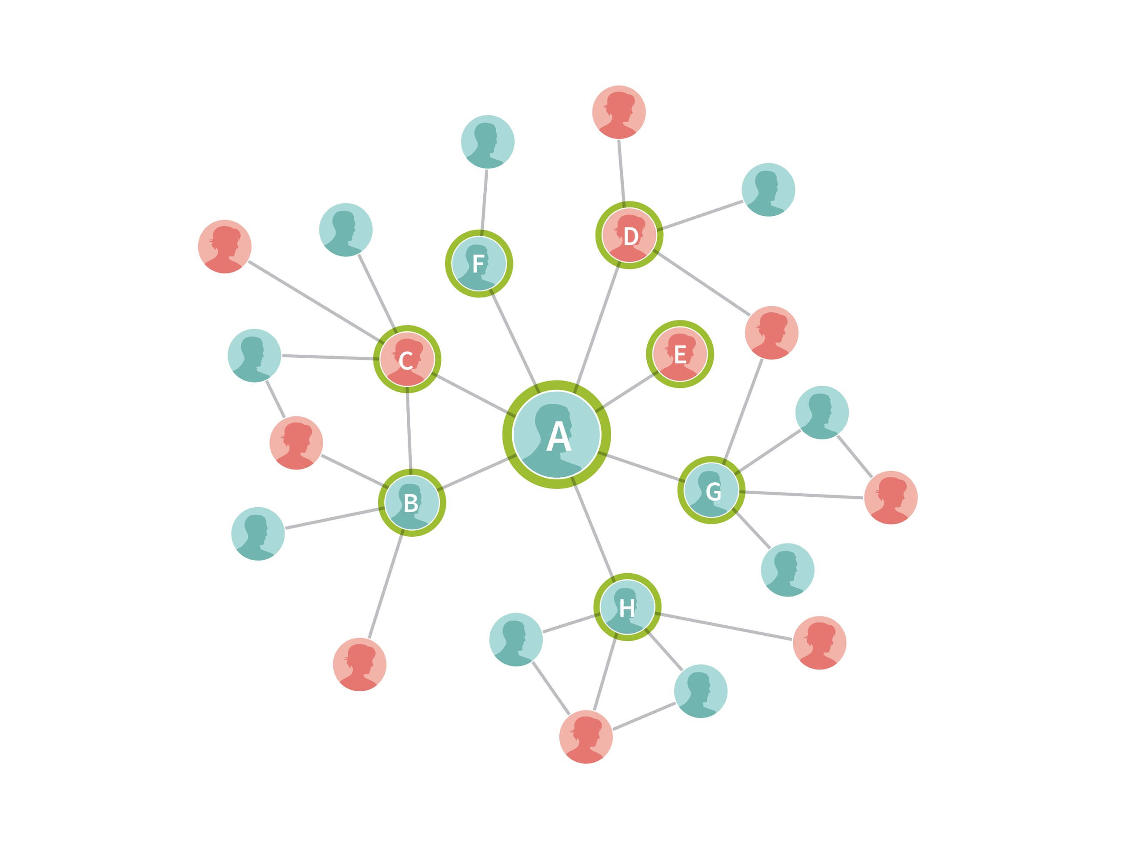
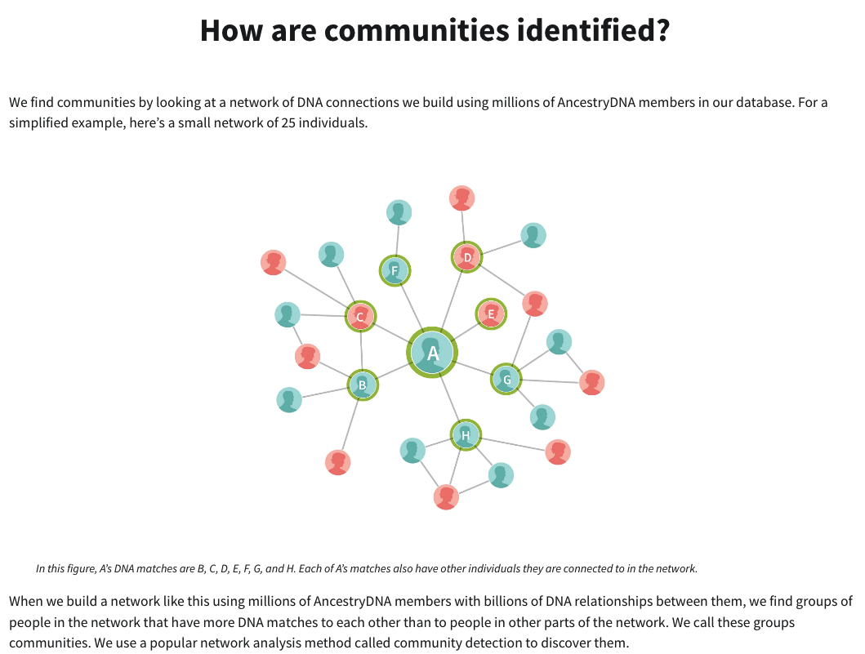
DNA Communities
How are communities identified?
We find communities by looking at a network of DNA connections we build using millions of AncestryDNA members in our database. For a simplified example, here’s a small network of 25 individuals.
In this figure, A’s DNA matches are B, C, D, E, F, G, and H. Each of A’s matches also have other individuals they are connected to in the network.
When we build a network like this using millions of AncestryDNA members with billions of DNA relationships between them, we find groups of people in the network that have more DNA matches to each other than to people in other parts of the network. We call these groups communities. We use a popular network analysis method called community detection to discover them.
Login to DNA Communities
Build a Network
Find Communities
Annotate with Pedigrees
Build with Classifiers
Notes:
Click the link to Communities and review.
Share page 10 (handout) and Research Log
https://www.yourdnaguide.com/ydgblog/finding-dna-matches-outside-the-us
Share Stories; Henry WWI Draft

Slide 21
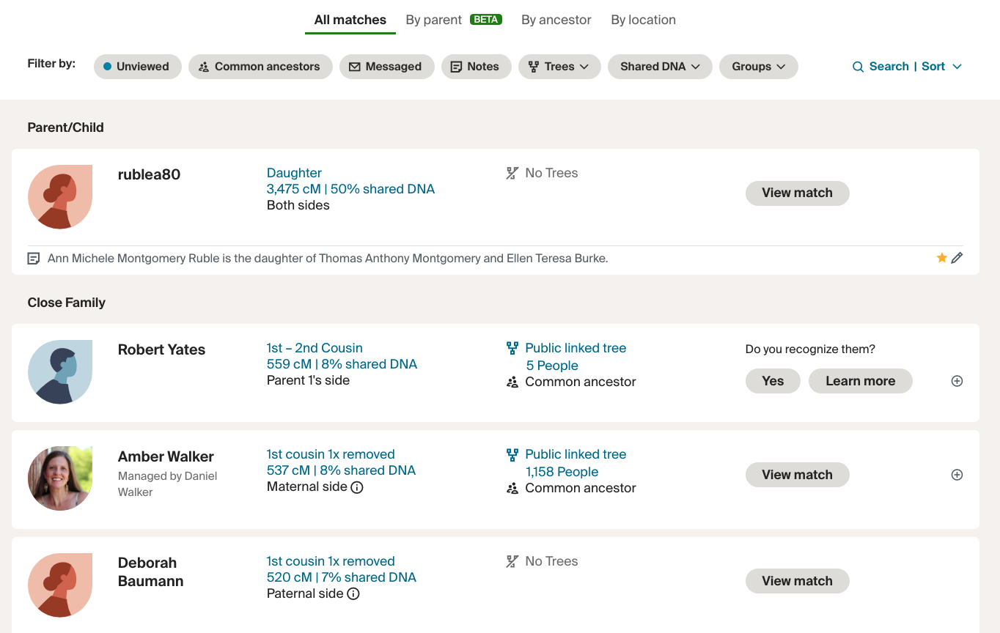
DNA Matches
Begin with known relatives
Work your way back
Establish a Cousin Chart
Create a Research Log
Cooperate!
Sharing your DNA Results
Southard
Ancestry
Cousins?
Notes:
Sort DNA Matches by Place:
Outside US: https://www.yourdnaguide.com/ydgblog/finding-dna-matches-outside-the-us

Slide 22
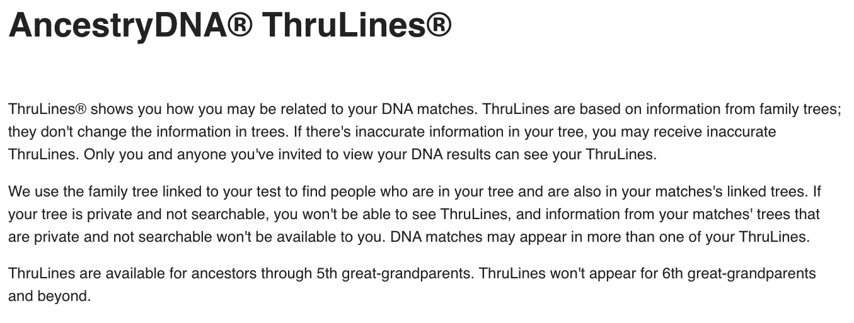
Ancestry Launches ThruLines
To see your ThruLines, you must have your tree linked to your DNA account.
Notes:
Review chart and relationship with Amber.

Slide 23

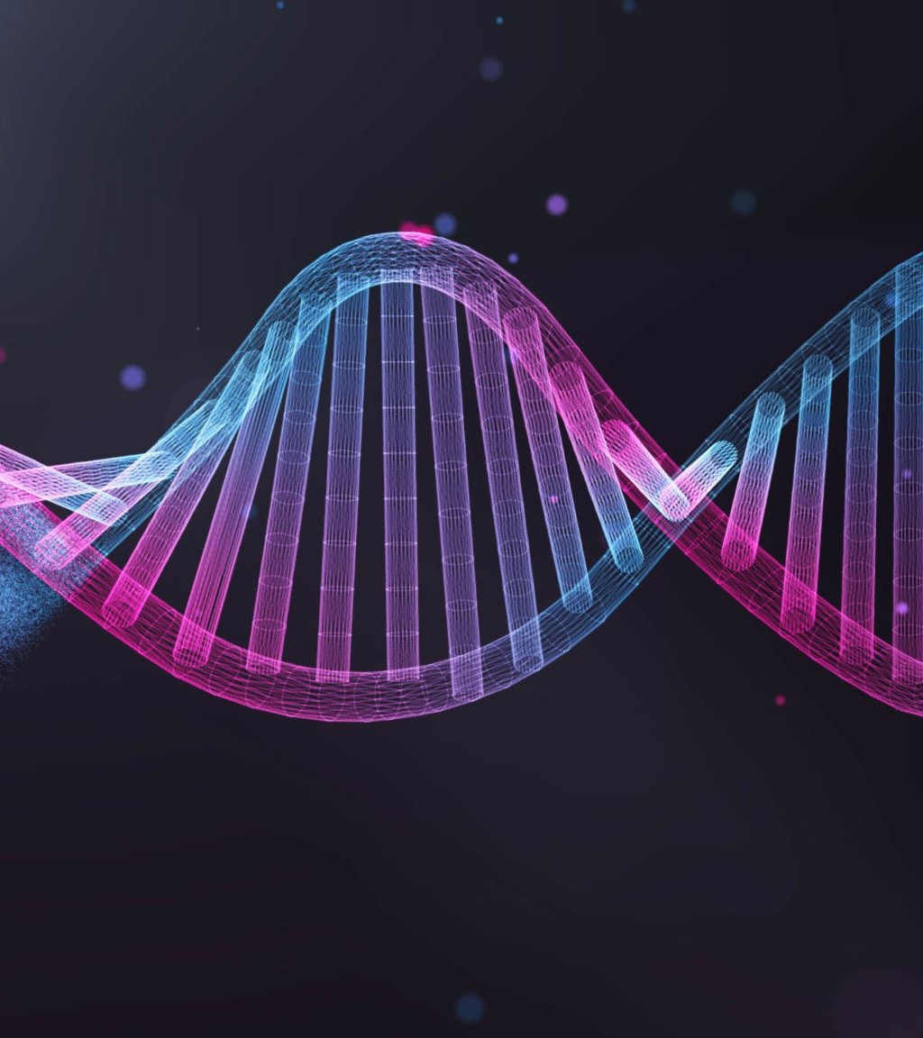
References
What is a centimorgan (and chart)?
Centimorgans vs. Generations
Understanding cM Chart and DNA
The Shared cM Project -v 4.0 and DNA Painter (handout)
Amounts of Shared DNA-major sites
Ancestry DNA Overview and Links
How to Understand your Ancestry DNA Results, Part 2
Cousin DNA Chart
Your DNA Guide (print or eBook)
Family Tee Guide to DNA Testing
The Genetic Genealogist
3 Quick Ways to Get a Family Tree to Attach to Your DNA Test Results

Slide 24
Latest Genealogical News
Mapping-free Library of Congress interactive map: Chronicling America
AncestryDNA Chromosome Painter Beta tool launched in July 2022 assigns DNA ethnicity estimates to each of your parents, then applies that information to 22 specific chromosomes and displays it as a graph. Private unless you wish to share.
Fly Over your ancestor’s home using Vintage Aerial, you can explore and help identify over 17 million aerial photos taken between the 1960’s and 2000s.
Ancestry Lauches SideView

Slide 25
January Genealogy Meeting
Zoom only: live from St. Louis.
Use this link at 2:00 Eastern Standard time on Sunday, January 15: https://siue.zoom.us/j/98759323363?pwd=OGsrdTBCaGVVUDkwcW5IMlg5dVR5Zz09
St. Louis, like Cincinnati, was a center of German immigrant activity. Dr. Andrew Theising will Zoom with us to share several sources of genealogy available to people researching relatives with ties to the St. Louis region.
Dr. Theising will review several online sources available in the STL region, including Catholic records, property records, and local histories.

Slide 26
Research
Happy Gene Mapping!

