Slide 1
What’s New in
Family Search
Dr. Thomas A. Montgomery

Slide 2
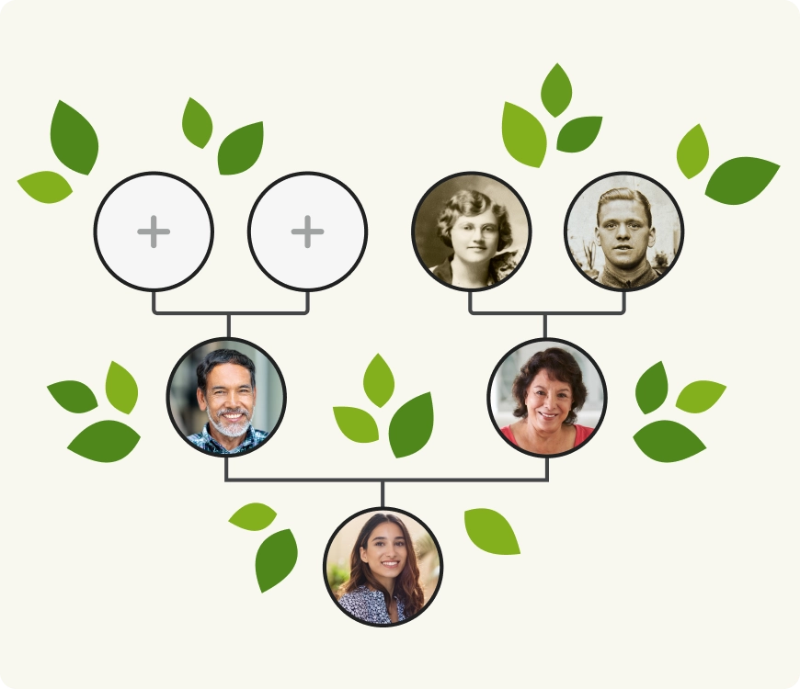
Family Search - Overview
FamilySearch is one of the biggest free genealogy websites in the world
Free access to all record collections.
Today, the FamilySearch website contains more than 8 billion names, 3.2 billion digital images, and almost half a million digitized books.
Over 1 million new records are added each day.
Some collections are only accessible from Family History Centers and/or affiliate libraries.
FamilySearch is truly the most global in scope.

Slide 3

Family Search – What’s New
Family Share
Portrait View
Memory Viewer
FamilySearch Labs
Mobile App – Android
Chat

Slide 4

Family Share
Share Family Information
A worldwide, public tree that is free to use
Work together to research their genealogy-same tree
Users can now share, add to, and modify information about living family members
Take Advantage of Each Family Member’s Strengths
Connect your living family
Foster unity
Share and protect
Leave a legacy
Tutorial

Slide 5

Portrait View
Portrait view family tree chart (or pedigree chart) is organized vertically
Your profile is in the middle of the chart, with your ancestors above you and your descendants below.
Makes the pedigree chart more effective and convenient
  View siblings
  View a single family line
  View multiple family lines at the same time
  Add relatives quickly without leaving the page
  Distinguish living individuals more easily
Tutorial
FamilySearch offers multiple views for organizing and presenting your genealogy: landscape, portrait, fan chart, descendancy, and first ancestor. Depending on your goals and interests, each view can provide you with a unique pathway for exploring your family tree. The Family Tree’s portrait view was recently updated to make exploring and expanding your family lines easier on the web.

Slide 6
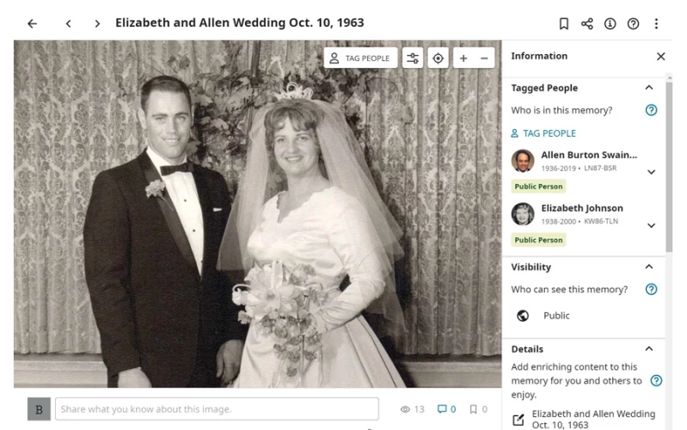
Memory Viewer
Memories, FamilySearch's hub for sharing images, audio recordings, and stories about your loved ones, has a new look.
  Bigger Area for Viewing Memories
  More Consistent Look
  Tagging Mode (for mobile users)
Try Out Memories
  Organize by topic
  Create a slideshow
  Share an album
  Bookmark important memories
  Let your memories be seen
  Enjoy your family memories in one place
The former version of the memory viewer was built years ago using technology that is now considered old. This release of the memory viewer was mostly about updating the underlying technology. We have many exciting features planned and the updated technology enables FamilySearch to speed up the development of these new features.

Slide 7

FamilySearch Labs
Get Started on Labs
    To get started, simply click on the Try It button for each new experience. Some experiments will have instruction pages that explain more about the feature and what type of feedback FamilySearch teams are looking for.
  Current Topics
    Testing Family Group Trees
    Testing a FamilySearch AI Assistant
    Testing a Full Text Search
    Testing a "Together" App
  Try It Here
Labs is a part of the FamilySearch site where you can explore emerging FamilySearch features that are not yet ready for public release. The new site is a chance for you to see what FamilySearch is working on and an opportunity for you to give your impressions of the new features.

Slide 8
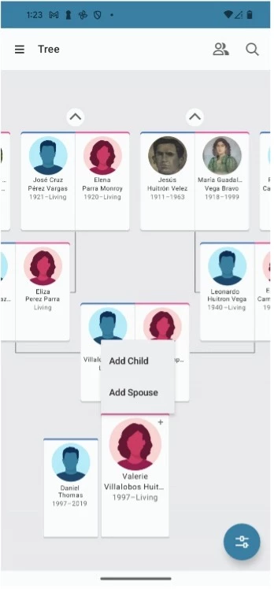
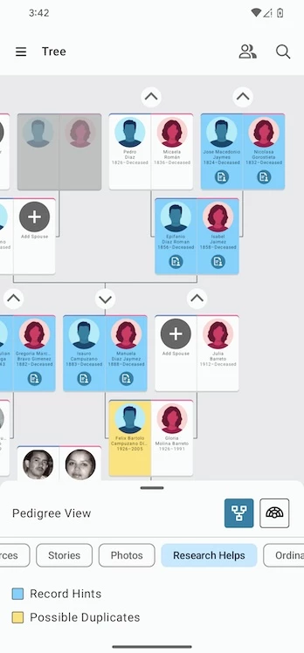
Mobile App - Android
Add Spouses and Children Directly from the Pedigree
It is now possible to add spouses and children to a person with ease, even if no other spouses or children are shown.
Show Record Hints and Other Indicators on the Pedigree View
While in the pedigree tree view, you can also hide or show hints and other indicators to help you focus on part of your tree.

Slide 9
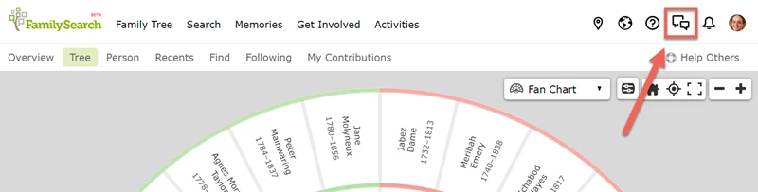

Chat
FamilySearch Chat is a new messaging system on FamilySearch.org.
It replaces the old FamilySearch messaging system.
Chat enables real-time conversation with any FamilySearch users signed in at the same time as you.
If people you are messaging are not signed in when you send a message, they will see your message the next time they sign in and open the chat tool.

Slide 10


Summary
References
  Finding Records and Preserving Memories (video)
  Tech Forum (video)
  Create a Family Tree Keepsake (designs & clip art)
  Compare Top 3 Websites
  Compare Top 4 Websites
  Genealogical Giants (4)
  Top Genealogy Websites (4)

Slide 11


Updates
German Genealogy Group
What’s New at Family Search?
What’s New at Ancestry?
Find My Past Fridays
Kolping Genealogy
  April - NO Meeting: Easter Sunday
  May - LIVE only workshop – no Zoom
  June - NO Meeting: Schützenfest
  July - LIVE only session – no Zoom

Slide 12
Research
Happy Hunting!

