Slide 1
German Internet Resources

Slide 2
montgota@gmail.com

Slide 3

German Internet Resources
Much Abounds
Growing More and More
More sites here in States than in Germany
GermanRoots

Slide 4


German Internet Resources
History
Religion
Heimat

Slide 5



German Internet Resources
Translate
Dictionaries
Phonetics
Pronunciation

Slide 6
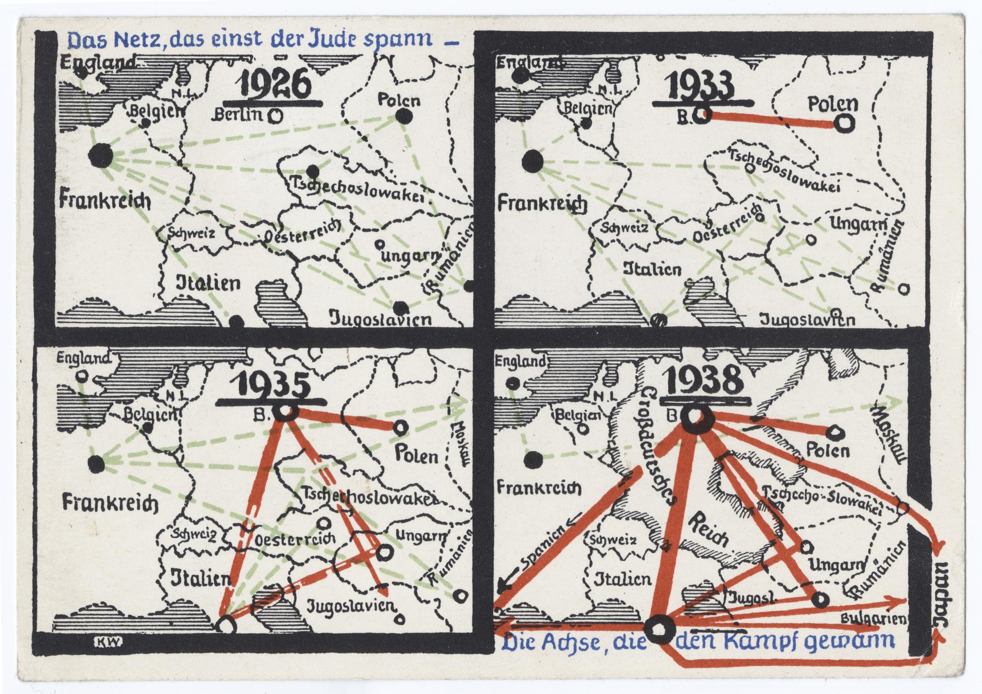

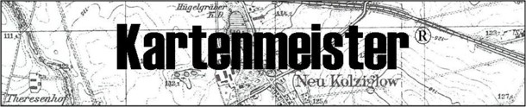
German Internet Resources
Surname Maps
Historic Maps
Google Maps
Gazetteers

Slide 7
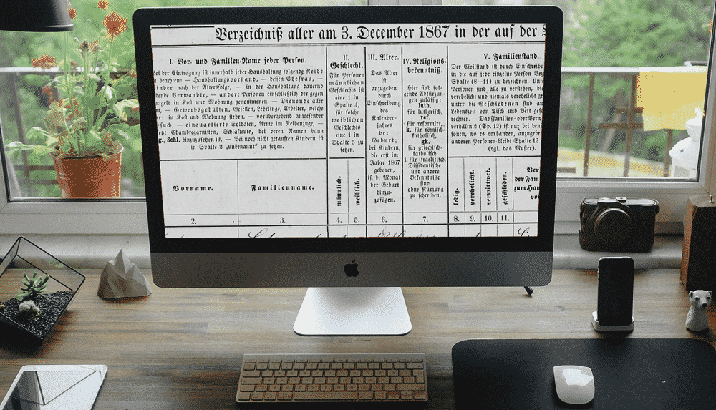

German Internet Resources
General Resources:
Familysearch.com
Ancestry.com
MyHeritage.com
Genealogy.net
12 Best German Genealogy Sites

Slide 8
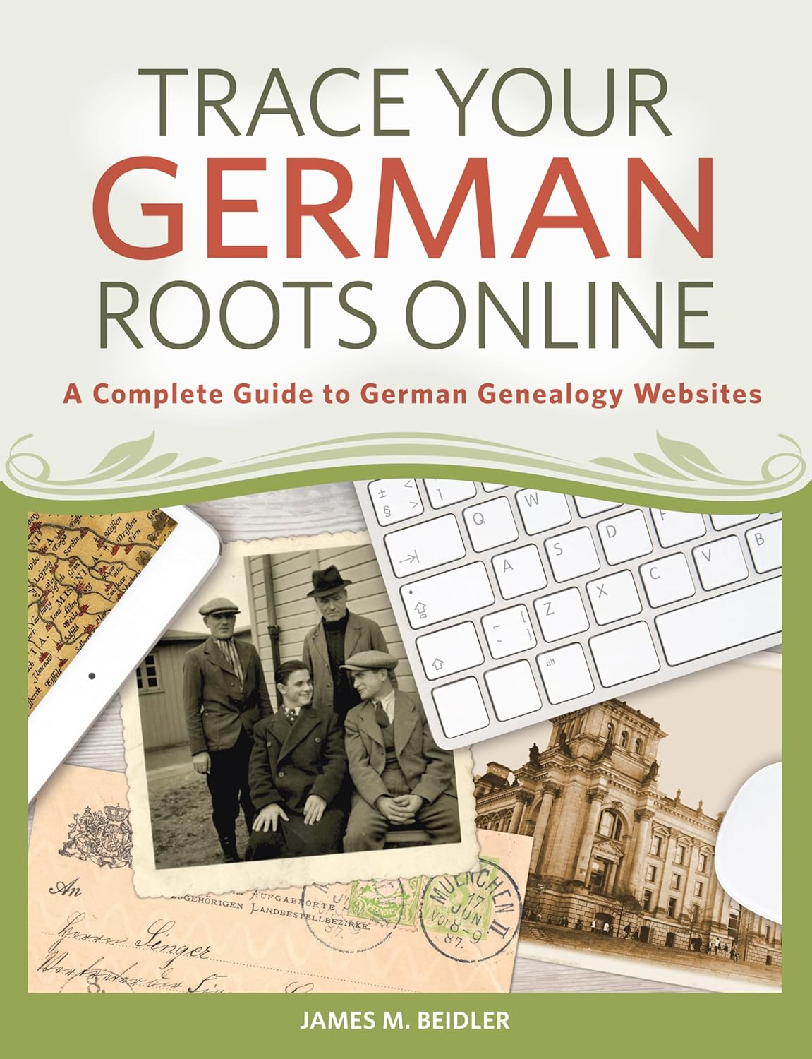
German Internet Resources
Highly Recommend:
James M. Beidler’s “Trace Your German Roots Online (2015)” Paperback)
E-book (2016)
New German Find-a-Grave

Slide 9
Research
Next Month-August 25
Planning Topics for 2024-2025

Slide 10
Research
Happy Hunting!

