Slide 1
United States Citizenship and Immigration Services – Genealogy
David F. Lahrmann

Slide 2

Finding Information on Relatives that Immigrated to the United States
United States Citizenship and Immigration Services (USCIS) Genealogy
  https://genealogy.uscis.dhs.gov/#/
About the USCIS Genealogy Program
  https://www.uscis.gov/records/genealogy

Slide 3
Why USCIS - Genealogy
The immigration laws/rules changed with time
  From the colonial period to today
Immigrant Registration
  Early 1900s the immigration process began to change
Immigrant Naturalization
  The process became standardized as time progressed
As a result of these laws/rules, changes in the immigration process required additional documentation and it was retained
A Brief History of U.S. Immigration Policy from the Colonial Period to the Present Day
  https://www.cato.org/policy-analysis/brief-history-us-immigration-policy-colonial-period-present-day#progressive-era

Slide 4
Records Available & What Time Periods
C-Files
  Between Sept 27, 1906 to Mar 31, 1956
Registry Files
  Entered the United States prior to July 1, 1924
Visa Files
  Took effect on July 1, 1924
Alien Registration Forms (AR-2s)
  Between August 1940 and March 31, 1944
A-Files
  Immigrant who arrived after April 1, 1944, or who naturalized after April 1, 1956
Not all immigrants will have all these files
  will depend upon their date of entry and their efforts to naturalize

Slide 5
Certificate Files (C-Files)
C-Files are a product of the Basic Naturalization Act of 1906.
  Created the Federal Naturalization Service and required the new agency to collect and maintain copies of all naturalization records nationwide.
  The C-File series later expanded to include records of U.S. citizenship acquired by derivation (naturalization by virtue of qualifying relation to another who is a birthright or naturalized citizen) and resumption or repatriation by former citizens that expatriated themselves (lost their U.S. citizenship).
The Federal Naturalization Service stored its citizenship records in C-Files.
Certain C-File documents are duplicated in the records of naturalization courts across the nation. Other C-File documents are unique.
https://www.uscis.gov/records/genealogy/historical-record-series/certificate-files-september-27-1906-march-31-1956

Slide 6
Certificate Files (C-Files)
Document naturalizations
  the acquisition of United States citizenship after birth
C-Files contain copies of records evidencing:
  Granting of naturalized U.S. citizenship by courts
  Granting of naturalized U.S. citizenship by courts between from 1906 to 1956; and
  Issuance of Certificates of Citizenship to those who derived or resumed U.S. citizenship.
Between from Sept 27, 1906 to Mar 31, 1956
https://www.uscis.gov/records/genealogy/historical-record-series/certificate-files-september-27-1906-march-31-1956

Slide 7
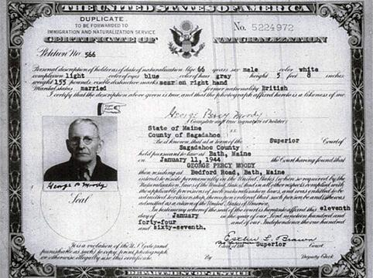
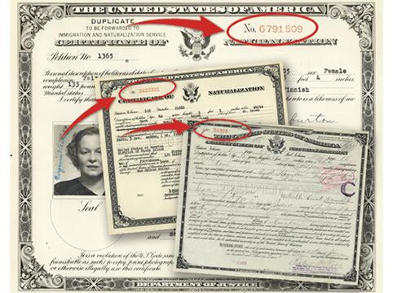
C-Files Image Gallery
Declaration of Intention
Petition for Naturalization
In Leu Application
Request for Certificate of Arrival
Certificate of Admission of Alien
Department of Labor Correspondence
Enemy Alien Exception
C-Files for naturalizations https://www.uscis.gov/records/genealogy/historical-record-series/c-files-image-gallery

Slide 8
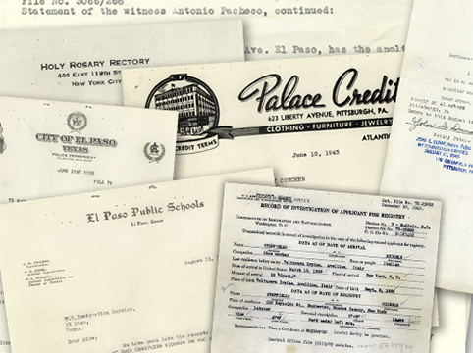
Registry Files
Applies to immigrants who entered the United States prior to July 1, 1924
Registry Files document the creation of official immigrant arrival record
  Registry Act of March 2, 1929 (45 Stat 1512)
  and for whom no arrival record could later be found
Potential documents
  Employment records, Reference letters, Account/Financial records, Church Records, Police/Criminal Background Check
https://www.uscis.gov/history-and-genealogy/genealogy/historical-record-series/registry-files-march-2-1929-march-31-1944

Slide 9
Visa Files
The Immigration Act of 1924 took effect on July 1, 1924
Law required all arriving noncitizens to present a visa when applying for admission to the United States
Immigrants requested visas at U.S. Embassies and Consulates abroad before their departure
The State Department only issued visa documents to approved immigrants and the Immigration Service only admitted immigrants arriving with a visa.
Visas allowed the Federal government to both select and limit the number of immigrants legally admitted for permanent residence
Visa files are the official arrival records of immigrants admitted for permanent residence between July 1, 1924, and March 31, 1944

Slide 10
Alien Registration Forms (AR-2s)
Alien Registration Forms documented the presence of noncitizens in the United States during the Second World War
Between August 1940 and March 31, 1944
The Immigration and Naturalization Service ("INS") used the Form AR-2 to make a record of all noncitizens residing in or entering the country
Record of all noncitizens residing in or entering the United States
Contained 5 forms: Registration Correspondence, AR-2, AR-AE-22/a, AR-AE-23, AE-11
https://www.uscis.gov/records/genealogy/historical-record-series/alien-registration-forms-on-microfilm-1940-1944

Slide 11
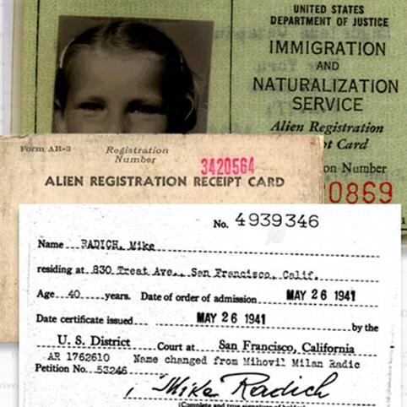
Alien Registration Forms (AR-2s)
AR-2 Alien Registration Forms
  https://www.uscis.gov/records/genealogy/historical-record-series/alien-registration-forms-on-microfilm-1940-1944
Correspondence relating to the registration of individual aliens
AR-AE-22 & -22a Application for Alien Enemy Certificate of Identification
  https://sites.rootsweb.com/~flmgs/crumbs/ALIEN_registration_records.pdf
AR-AE-23 Certificate of Identification
  https://www.archives.gov/files/research/immigration/case-files.pdf
AE-11 Alien’s Change of Address Card
  https://www.uscis.gov/ar-11

Slide 12
Alien Files (A-Files) - Background
The Immigration and Naturalization Service ("INS") started issuing each noncitizen a unique A-Number in 1940 as part of the Alien Registration Program
  On April 1, 1944, INS started using A-Numbers to create individual files, called A-Files.
  INS opened or consolidated A-Files for every immigrant who arrived after April 1, 1944 or naturalized after April 1, 1956, and for immigration law enforcement matters
  (see Alien Registration Forms)
Before A-Files, many noncitizens had more than one file with the agency.
  For example, an immigrant might have a Visa File, an AR-2, and a C-File. Accessing all agency records for an alien often required INS personnel to search multiple records systems and indexes. INS introduced A-Files to streamline its record keeping. Issuing each immigrant an A-Number allowed INS to create one file for each immigrant containing all the agency's records for the subject
A-Files contained all INS records of any active case of an immigrant not yet naturalized
  From April 1, 1944 to March 31, 1956
  When the agency opened an A-File for a noncitizen with previous agency records, INS consolidated its other records for the subject into the new A-File. Upon naturalization, INS consolidated (refiled) all agency records of the new citizen in his or her Certificate File ("C-File") and the A-File ceased to exist. Beginning April 1, 1956, INS started filing all agency records for active cases, including naturalization records, in the subject's A-File. USCIS continues this practice today

Slide 13
Alien Files (A-Files)
Numbered Below 8 Million
Alien Files, or "A-Files," are individual files identified by subject's Alien Registration Number ("A-Number").
  An A-Number is a unique personal identifier assigned to a noncitizen.
  A-Files became the official file for all immigration and naturalization records created or consolidated since April 1, 1944.
A-Files below 8 million are just the oldest fraction of the USCIS’ immense A-File series of more than 60 million case files.
Inactive A-Files are stored in various locations, with the majority held by USCIS.
https://www.uscis.gov/records/genealogy/historical-record-series/a-files-numbered-below-8-million

Slide 14
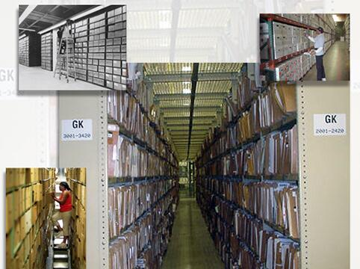
Alien Files (A-Files) - Image Gallery
Opened or consolidated for every immigrant who arrived after April 1, 1944,
Or who naturalized after April 1, 1956.
Immigrants who naturalized between 1944 and 1956 should not have an A-File.
In 2010 USCIS began the process of transferring A-Files of immigrants born more than 100 years ago to the National Archives.
The vast majority of A-Files remain in USCIS custody.
https://www.uscis.gov/records/genealogy/historical-record-series/a-files-image-gallery

Slide 15
Potential Documents
Birth certificates
Police records
Health records
Naturalization document
Country of origin
Photographs
Registration documents
Next of kin in their homeland
Port of entry document/s
Application for immigration documents
Declaration of Intention
Petition for Naturalization
Affidavit for support of application for VISA

Slide 16
Record Search – Information Needed
Need to know
  Family member’s
    Name
      First
      Last
      Alias Names
    Date of birth
      Year
      Month
      Day
    Place of birth
      Country and city
  Date of arrival to the USA
  The City/Location to which they went
  Relatives
    Spouses
    Children
    Siblings
Sources for this information
  Passenger lists
  Family Records

Slide 17
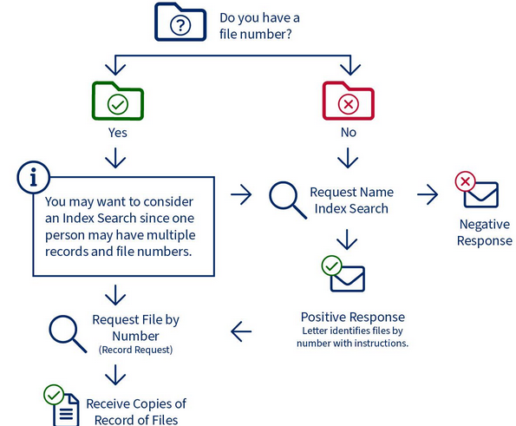
USCIS Genealogy - How Does the Process Work?
Start with USCIS Genealogy Page
  https://www.uscis.gov/records/genealogy
Need to have a Case ID
Order an Index or Search Request
  Requesting Records - Starting Your Search
  https://genealogy.uscis.dhs.gov/#/
Index Search Request (RED BOX)
  https://genealogy.uscis.dhs.gov/#/search
Record Request with Case ID
  https://genealogy.uscis.dhs.gov/#/cases/id

Slide 18
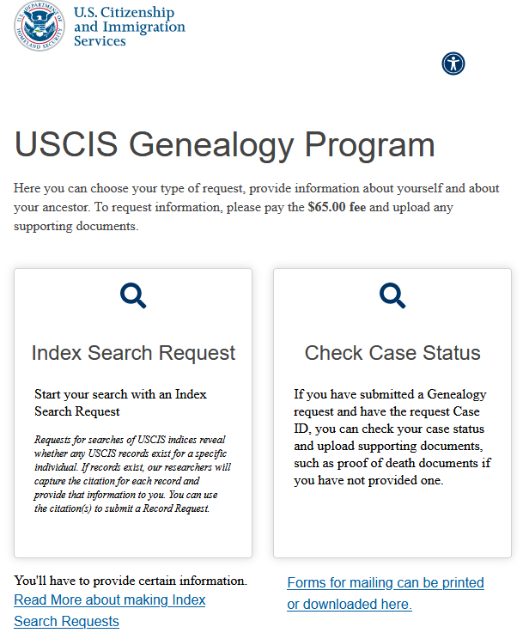
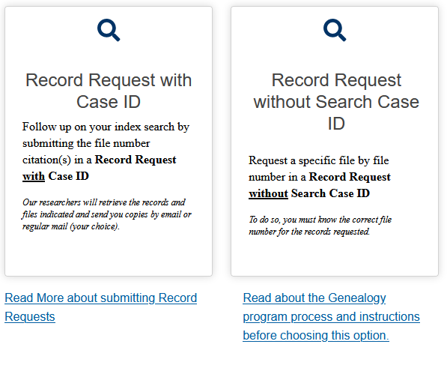
Search Process – Index Search Request
First – Index Search Request
  Start a “Index Search Request”
  It will cost $65.00
    Remember your answer to your “Secret Question” when you submit the application
  If there is a record for the person you will receive a Case ID number
Second – Record Request
  With the Case ID select the “Record Request with Case ID”
  Enter the information requested
  It will cost $65.00
  Records will then be provided by
    Via USPS
    Via USCIS MyAccount
  Delivery depends upon your selection

Slide 19
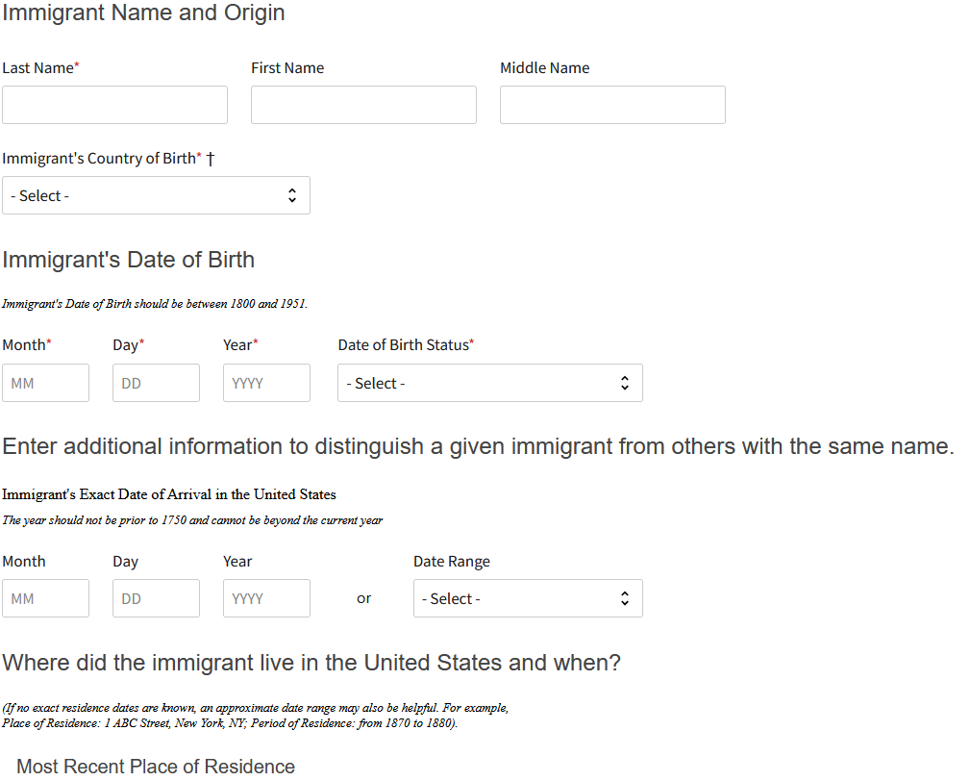
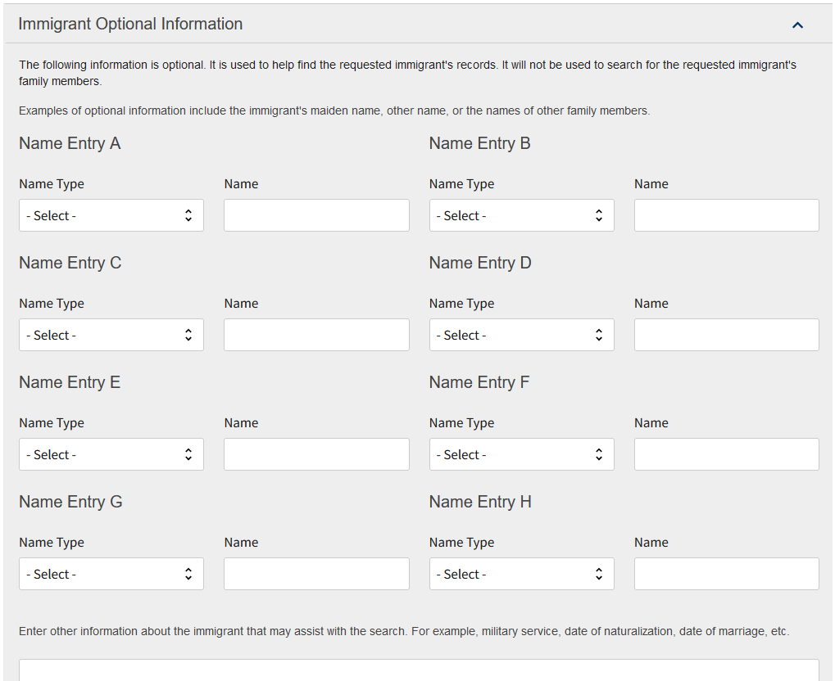
First - Index Search Request
Enter the information as indicated in the application
Includes your information
Then the person for whom you are searching
Include any supporting documents (pdf, jpg)
Submit and Pay
https://genealogy.uscis.dhs.gov/#/search
Outcome
“Case ID”

Slide 20
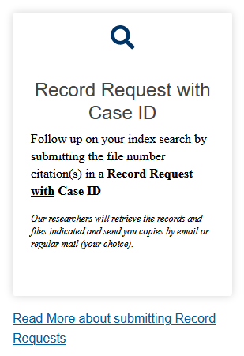
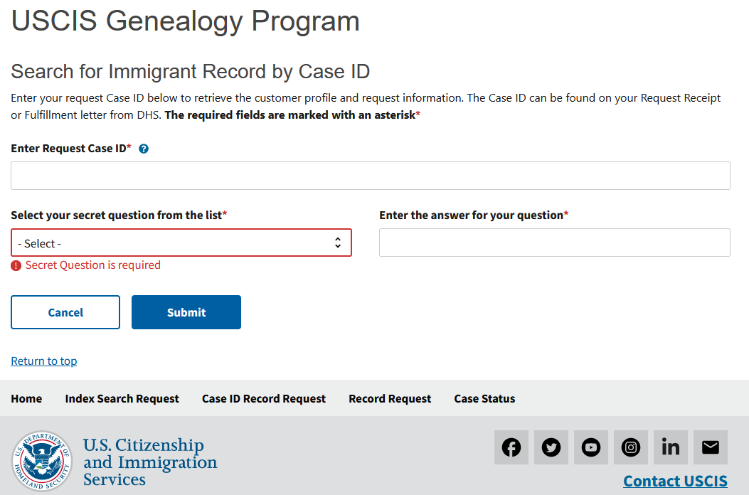
Second – Record Request with Case ID
Then Enter Case ID,
Have Case ID,
Choose Record Request with Case ID
https://genealogy.uscis.dhs.gov/#/cases/id
Provides status update on finding and delivering records

Slide 21
Recommendation – USCIS Account Registration
Skip the USPS delivery of a hard copy
Establish a USCIS MyAccount
Obtain the digital copies of the records that were download to the account after requesting USCIS Genealogical records
  Sign up for receiving information digitally
  Need to select this delivery method during Record Request submission
What is the link for the USCIS MyAccount website
  https://myaccount.uscis.gov/

Slide 22
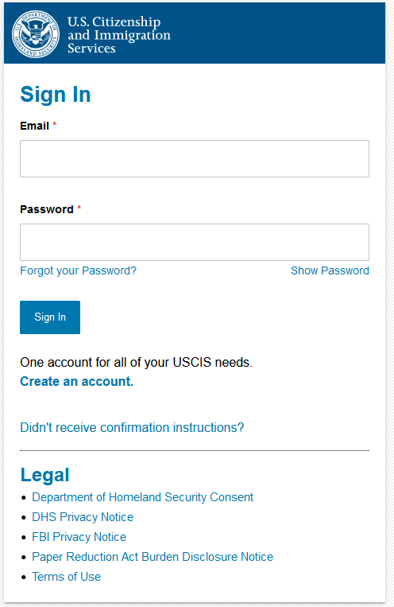
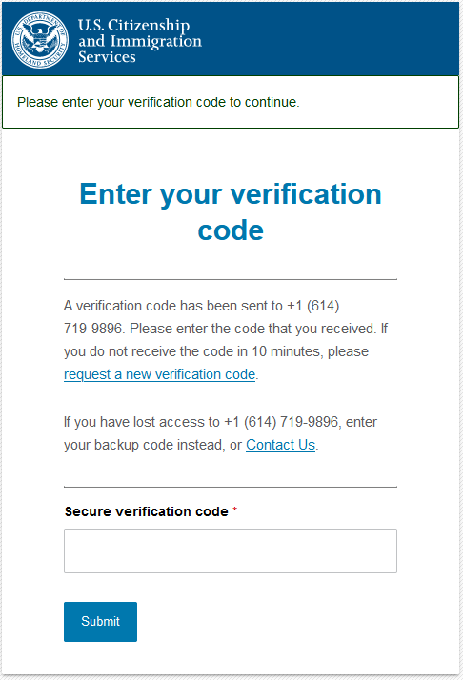
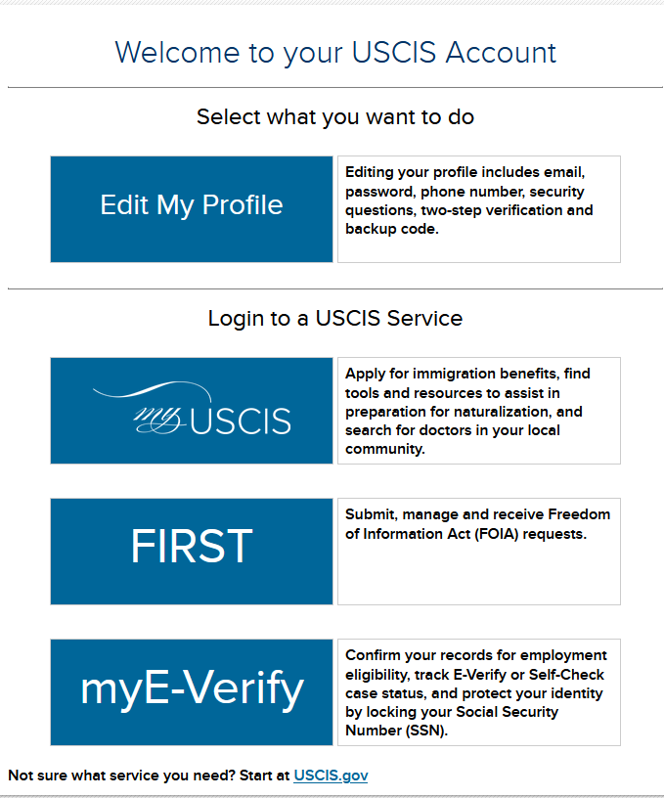
USCIS Login Process
Very important to select the “First” button first
If you select one of the others, you will have to wait 24 hours to get into your documents
This One!
Verify it is you
Must select the “First” button First to get to documents
Log into account

Slide 23
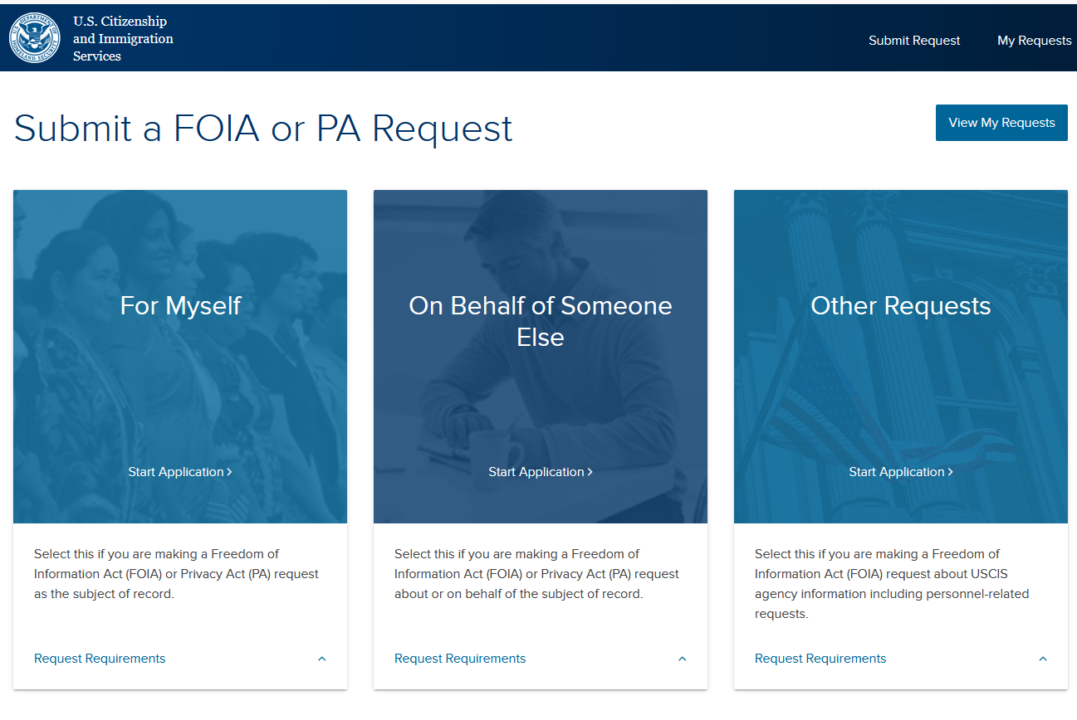
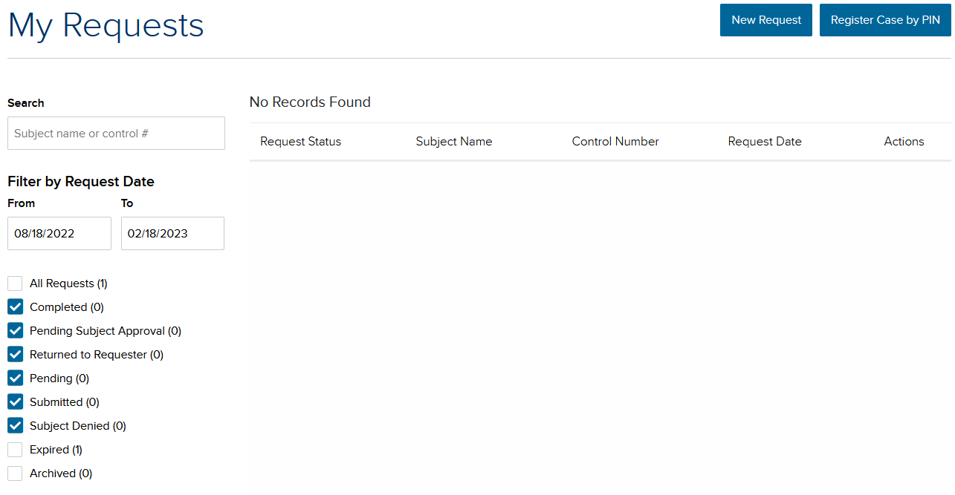
USCIS Login Process, Cont
Choose “View My Requests”
This is set to 6 months but can be adjusted to any time range
3) Next choose the record you want and then can download the PDF files

Slide 24
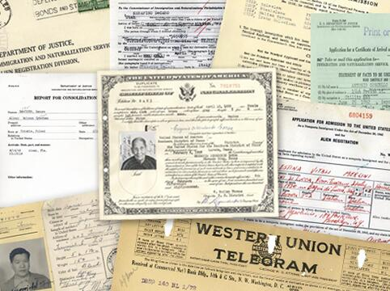
What you may Receive
The contents for each immigrant will vary
Depends upon
  what the immigrant submitted
  how far along they were in their naturalization process
  what USCIS actually retained and can find

Slide 25
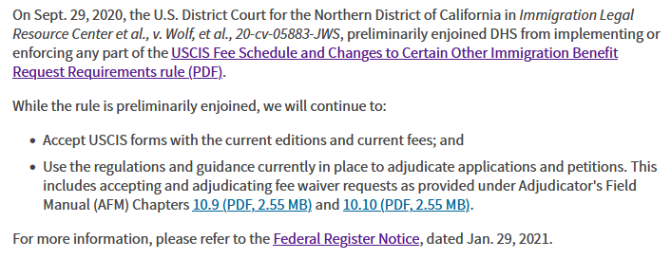
USCIS Fee Schedule and Changes
  https://www.uscis.gov/records/genealogy

Slide 26
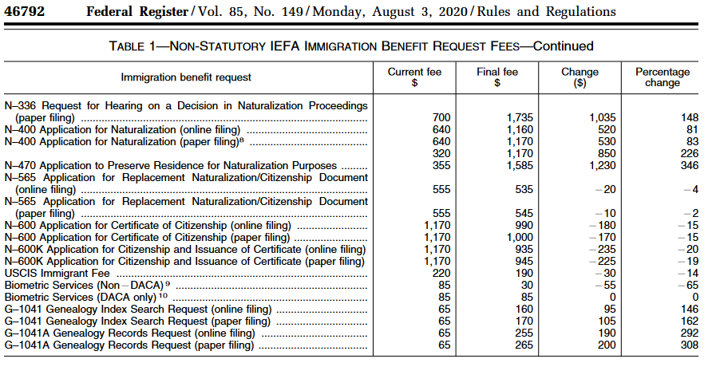
USCIS Fee Schedule and Changes
  https://www.uscis.gov/records/genealogy

Slide 27
USCIS - Time to Complete Request
Before COVID
  Case ID – average 11 days, range from 7 to 17 days
  Record – average 81 days, range from 23 to 227 days
After COVID
  Case ID – averaging 322 days
  Record – averaging 364 days

Slide 28
Summary
There is a lot of potential information contained in these records
Will depend upon immigrants' arrival and what records were retained
Collect the facts about the immigrant
Documents are also helpful to submit to USCIS for the Case ID search

Slide 29
Research
Happy Hunting!

